Slide 1
Supervised – Unsupervised learning Gradient descent algorithm
Học kỳ 1, năm học 2017-2018

Slide 2
Outline
Supervised learning
Unsupervised learning
Model representation
Cost function
Gradient Descent for linear regression

Slide 3
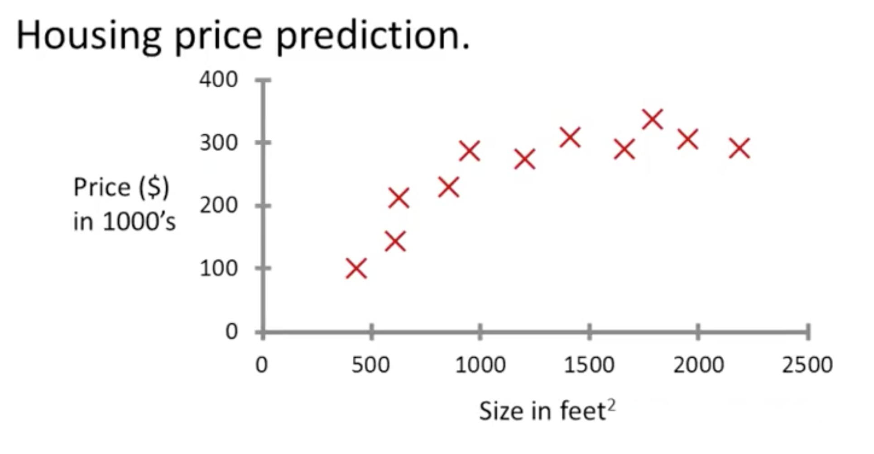
Supervised learning

Slide 4
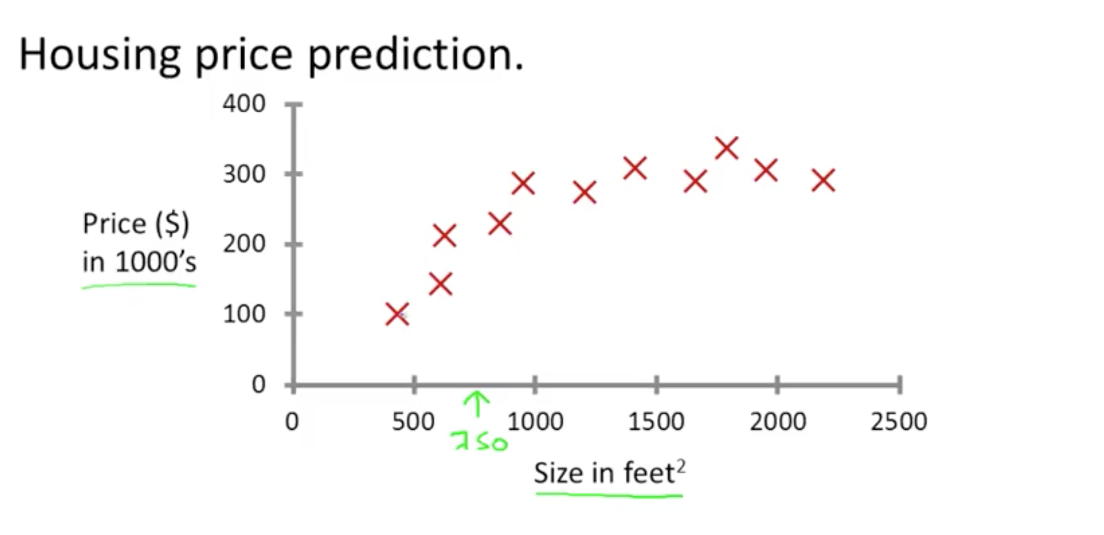
Supervised learning

Slide 5
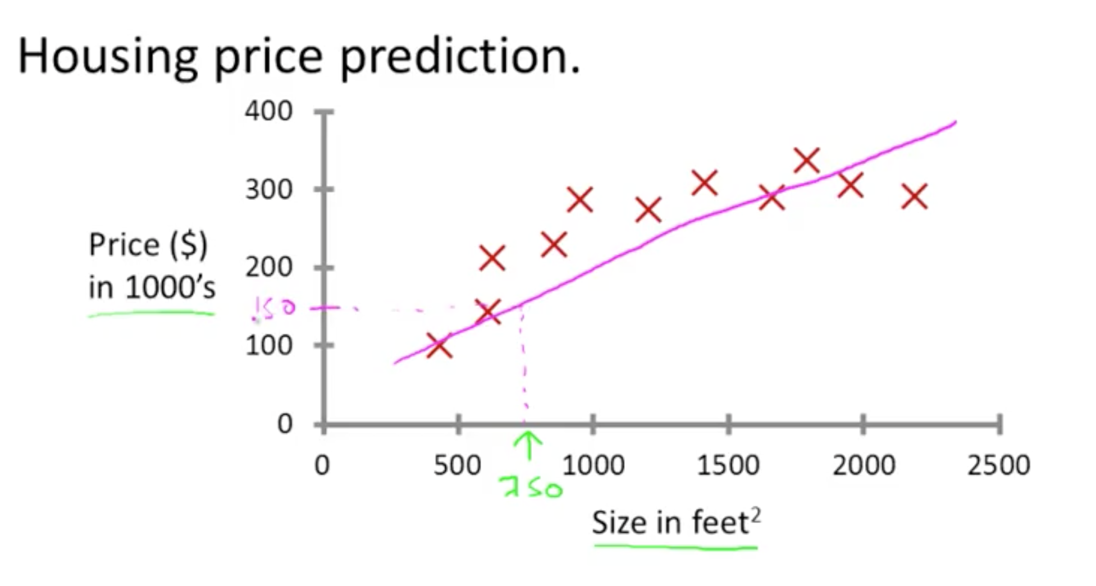
Supervised learning

Slide 6
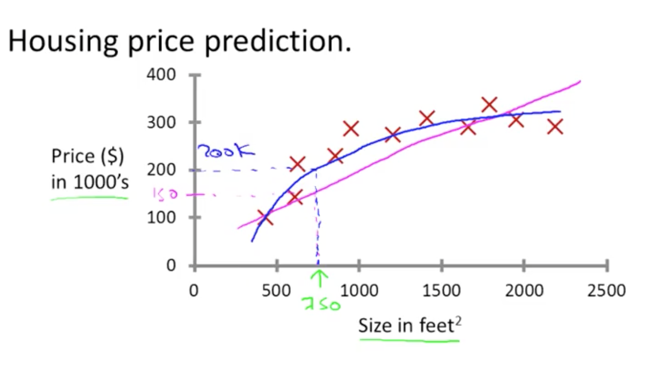
Supervised learning

Slide 7
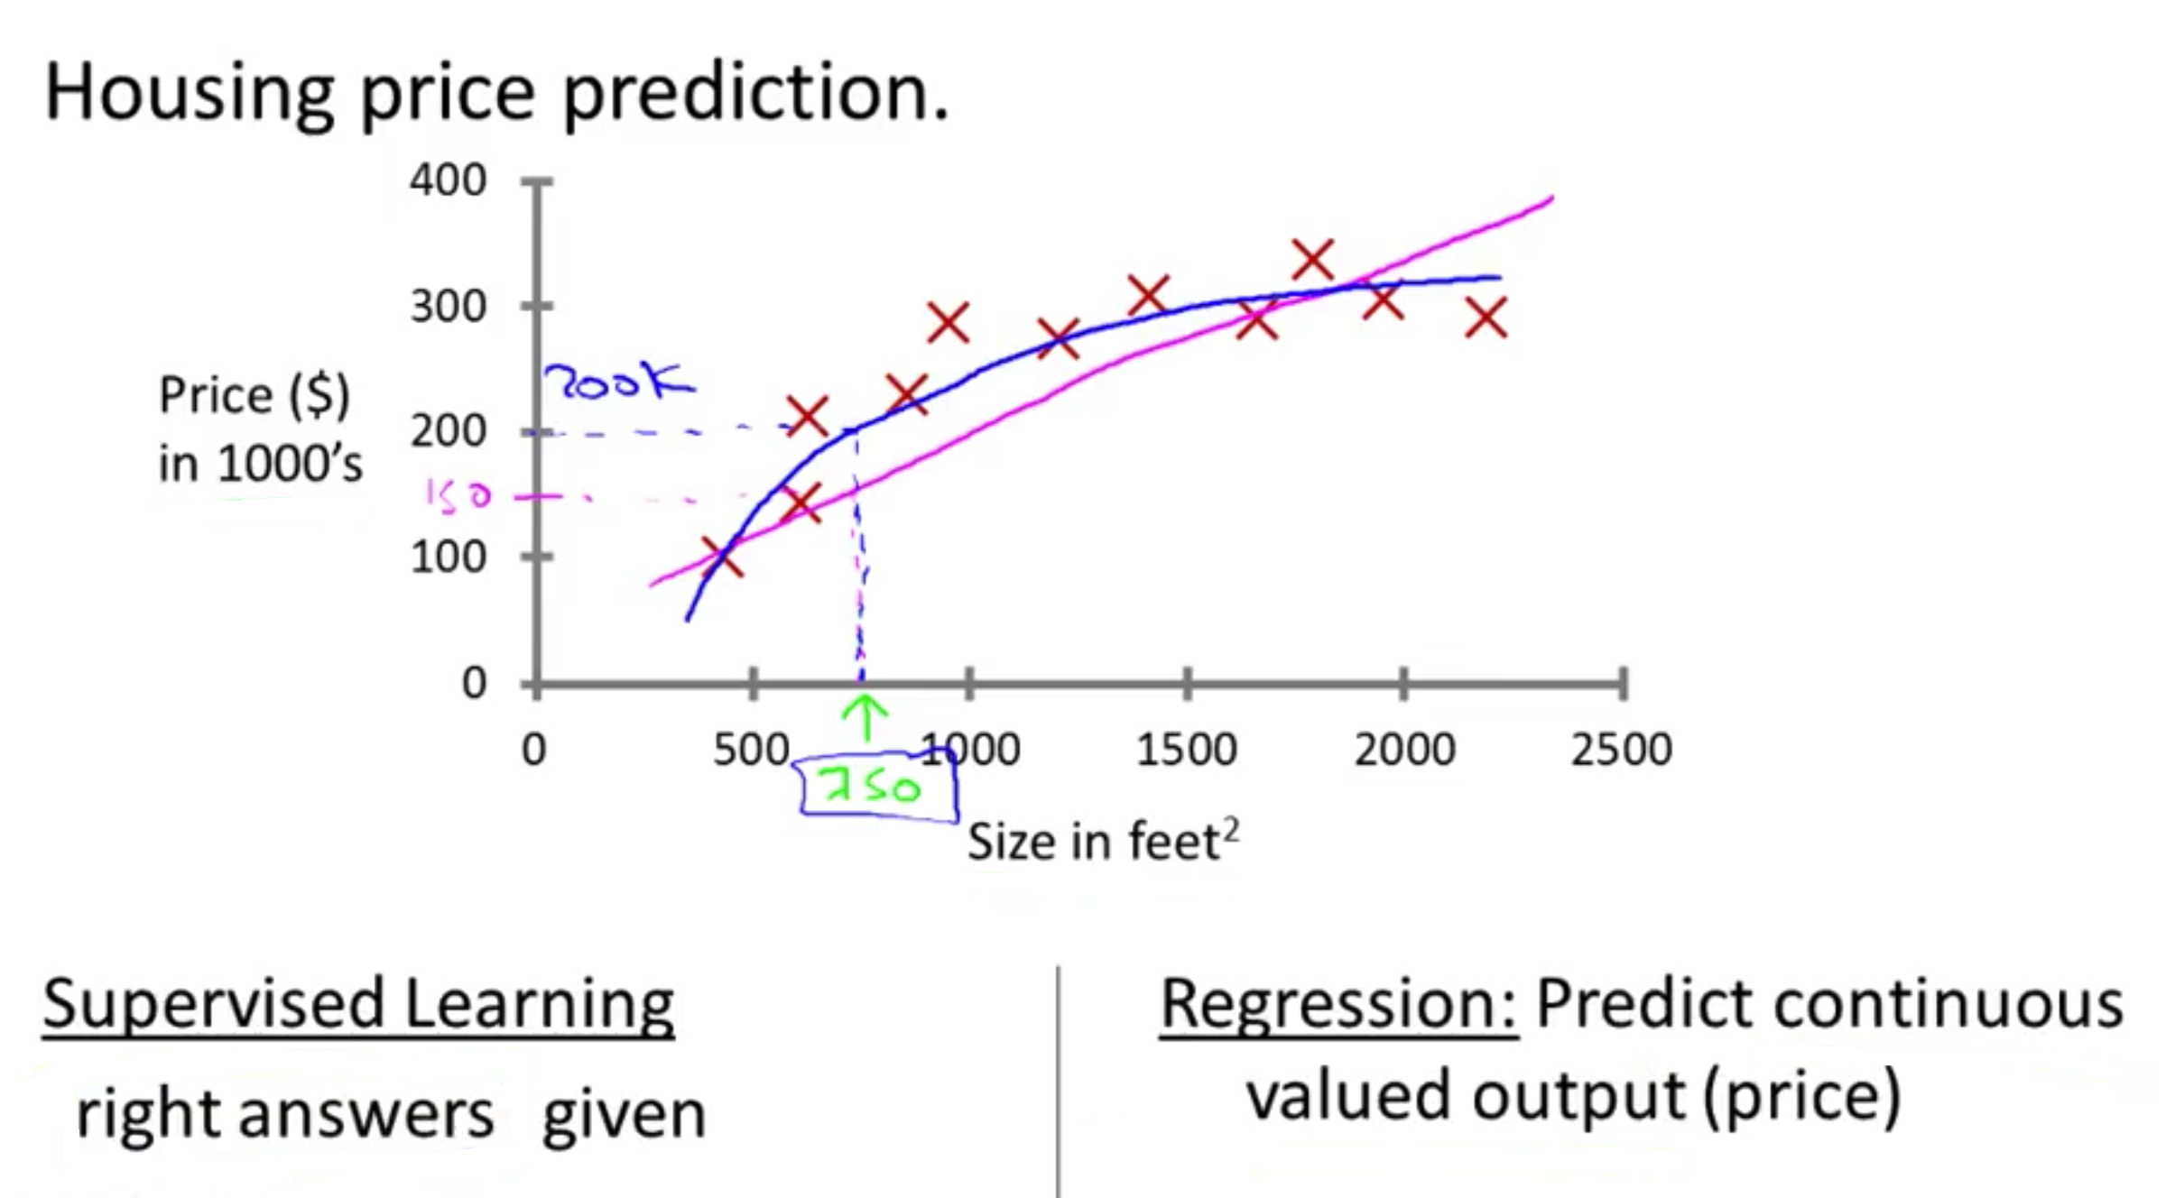
Supervised learning

Slide 8
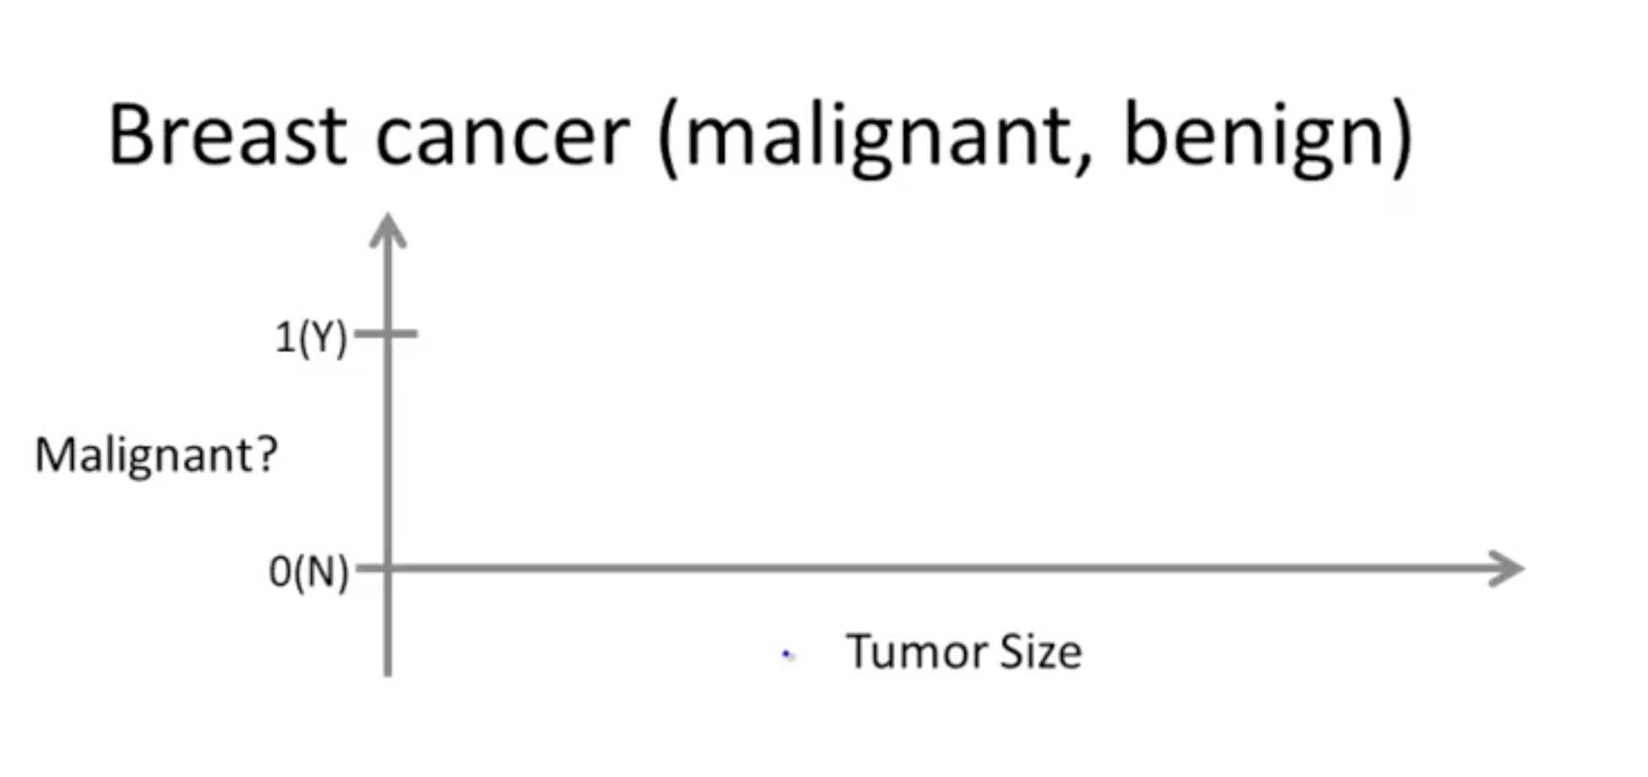
Supervised learning

Slide 9
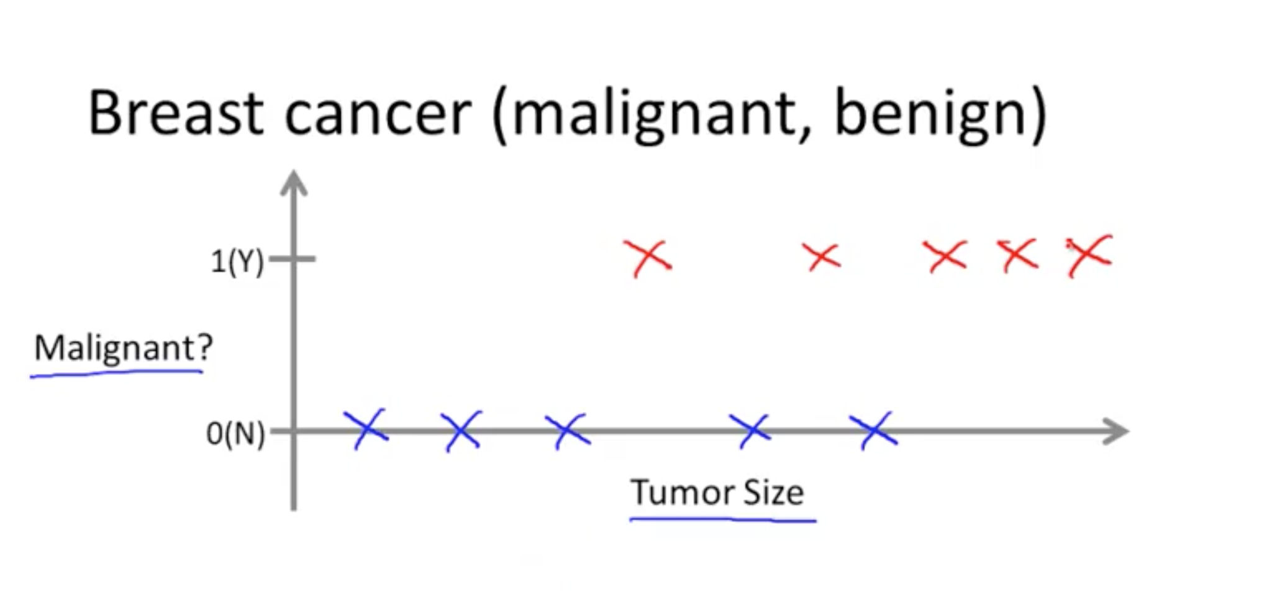
Supervised learning

Slide 10
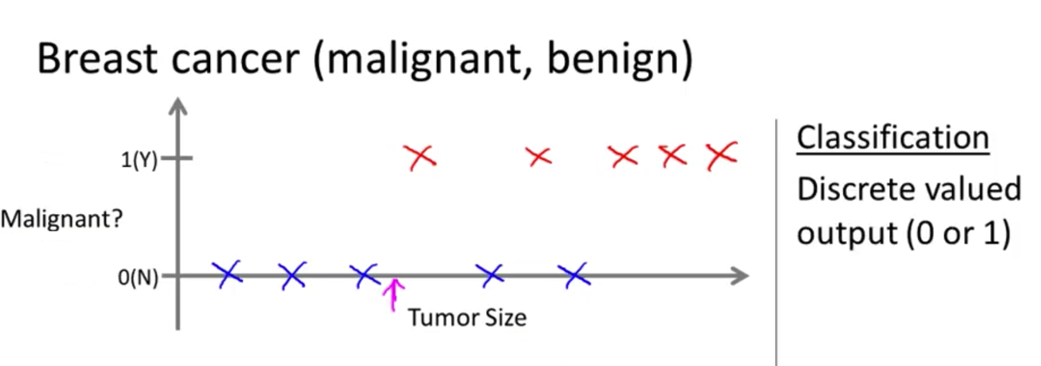
Supervised learning

Slide 11
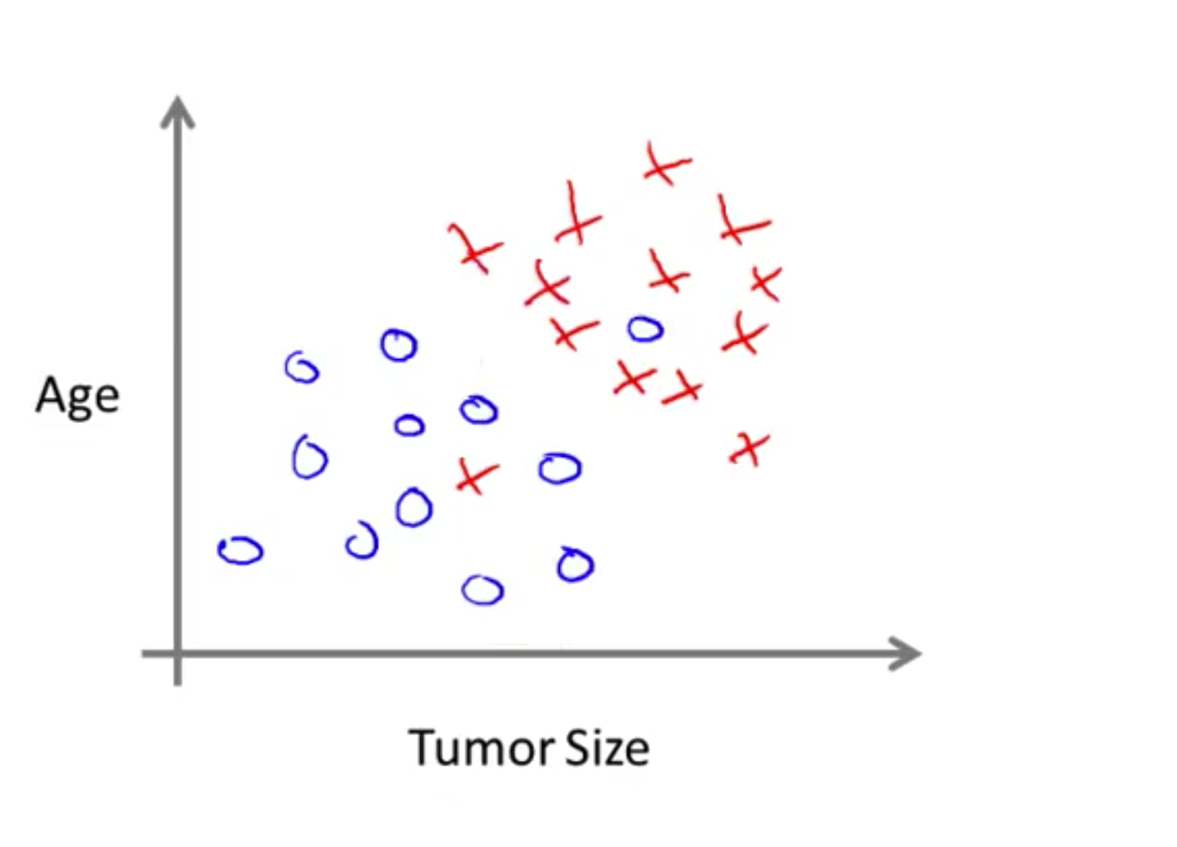
Supervised learning

Slide 12
You’re running a company, and you want to develop learning algorithms to address each of two problems.
Problem 1: You have a large inventory of identical items. You want to predict how many of these items will sell over the next 3 months
Problem 2: You’d like software to examine individual customer accounts, and for each account decide if it has been hacked/compromised.
Should you treat these as classification or as regression problems? A. Treat both as classification problems. B. Treat problem 1 as a classification problem, problem 2 as a regression problem. C. Treat problem 1 as a regression problem, problem 2 as a classification problem. D. Treat both as regression problems.

Slide 13
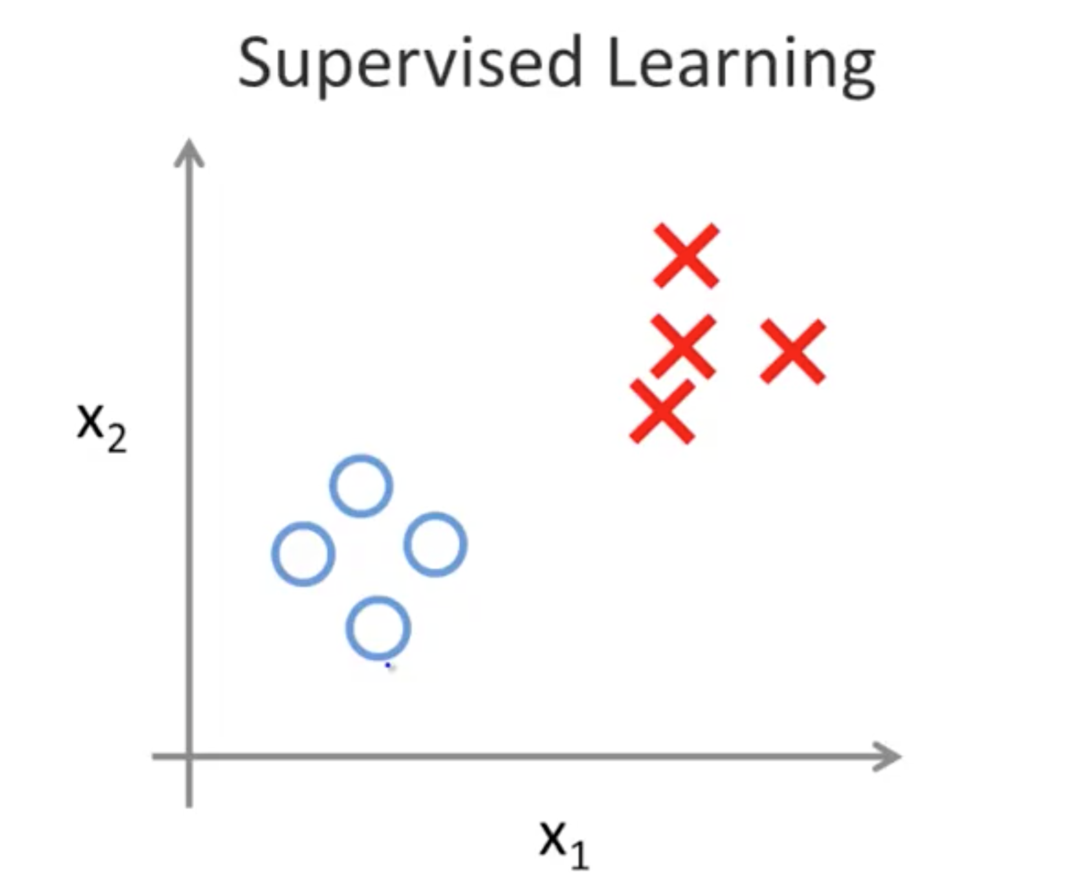
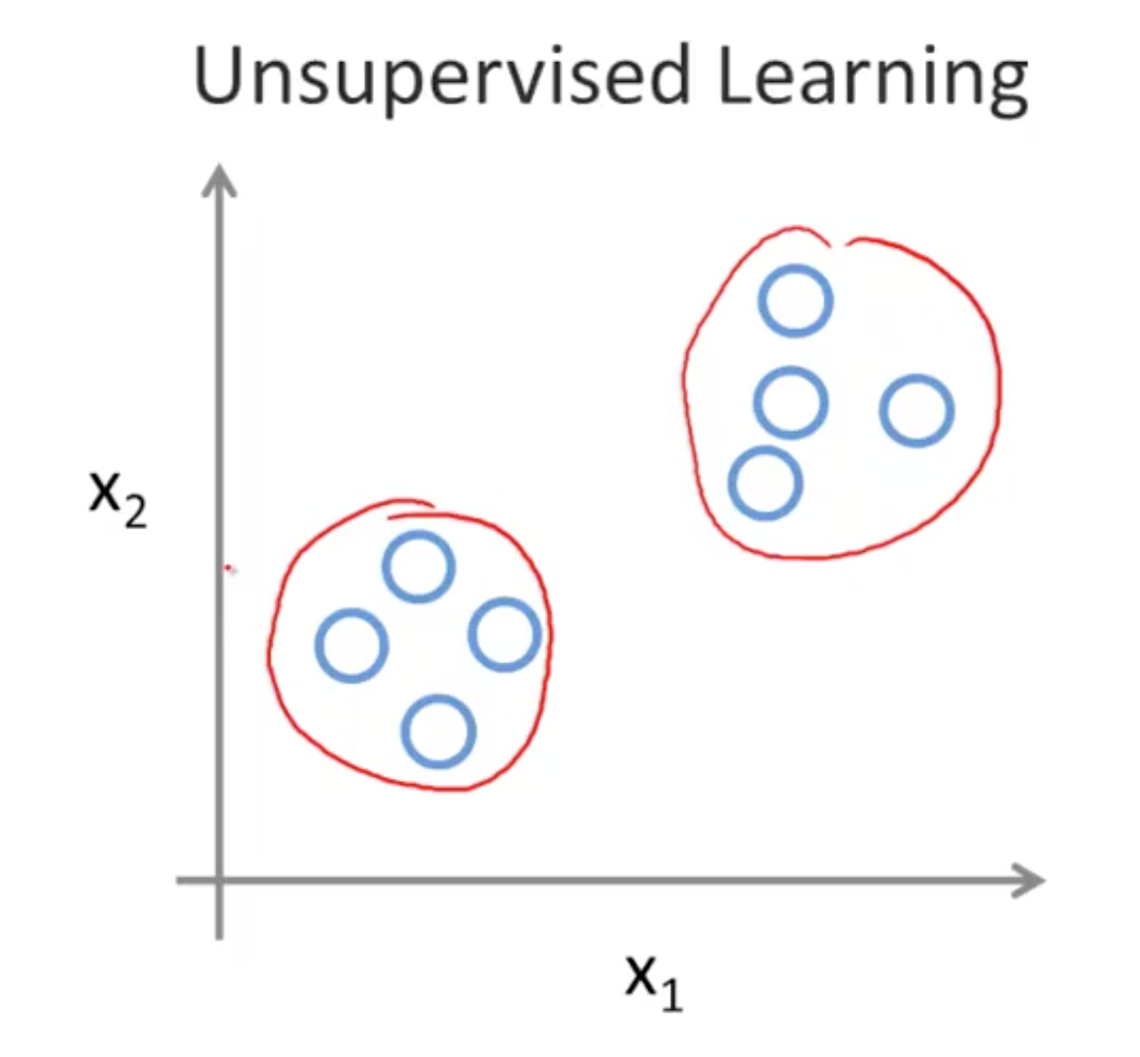
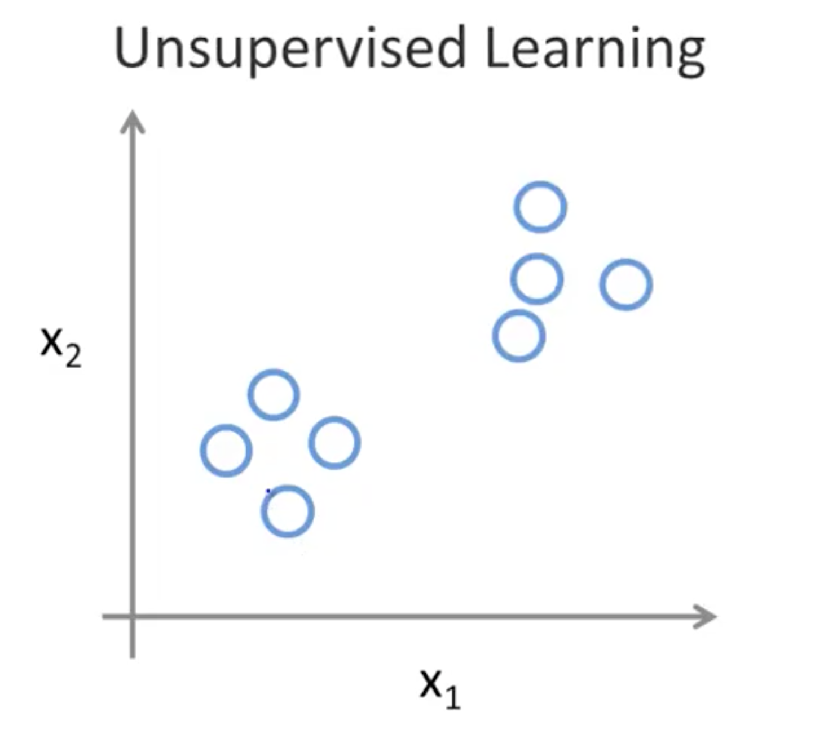
UnSupervised learning

Slide 14
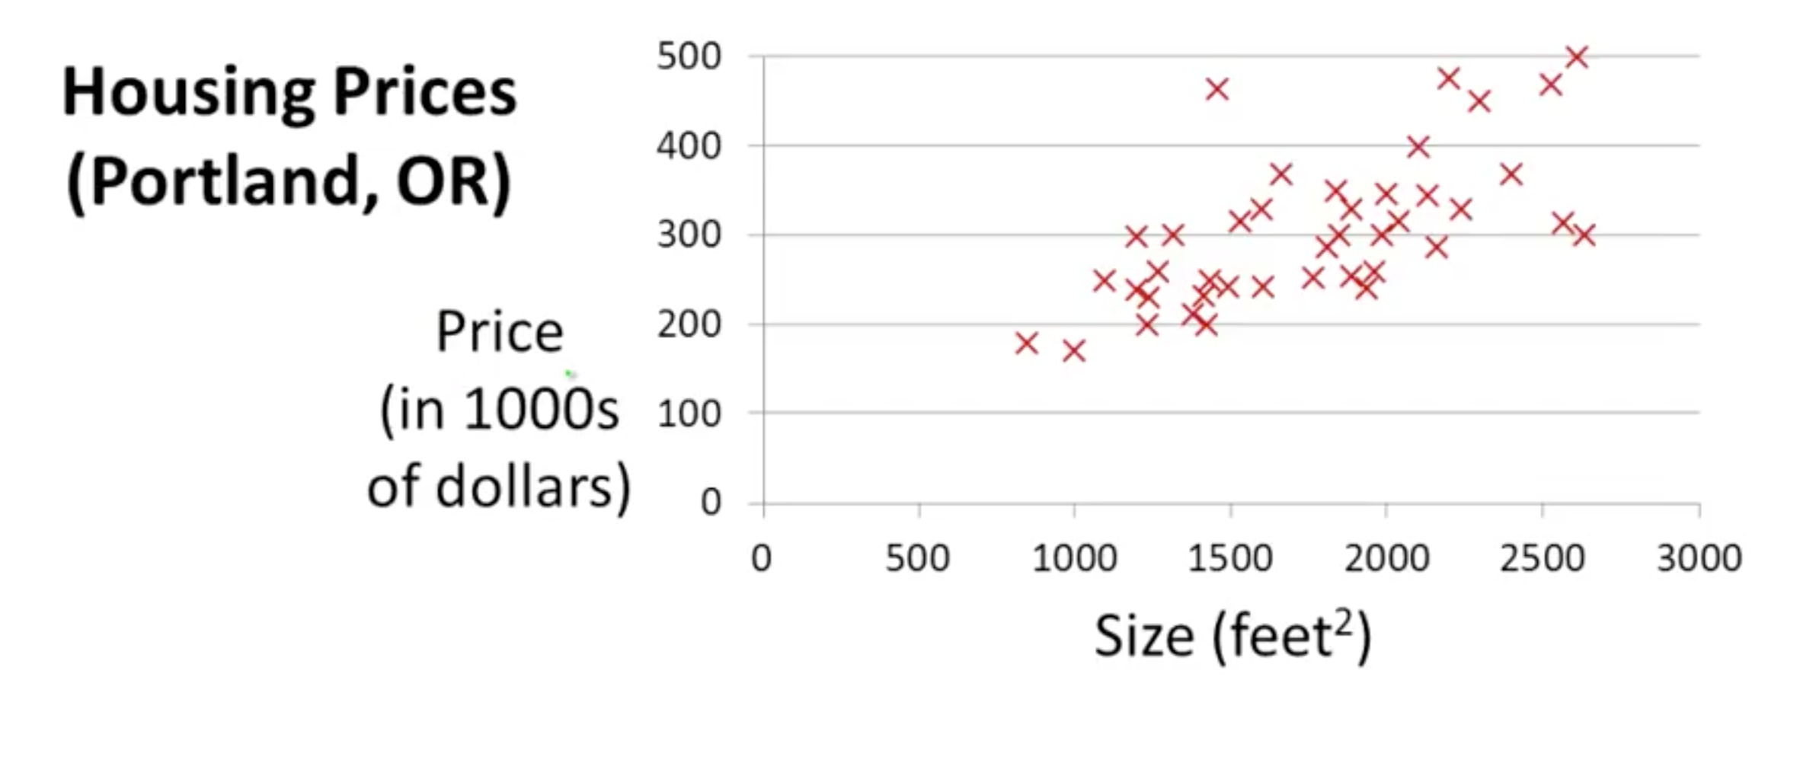
Model representation

Slide 15
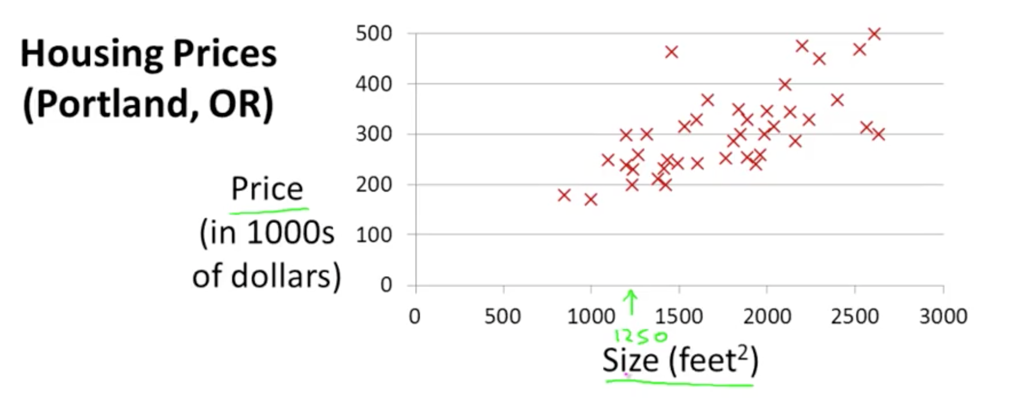
Model representation

Slide 16
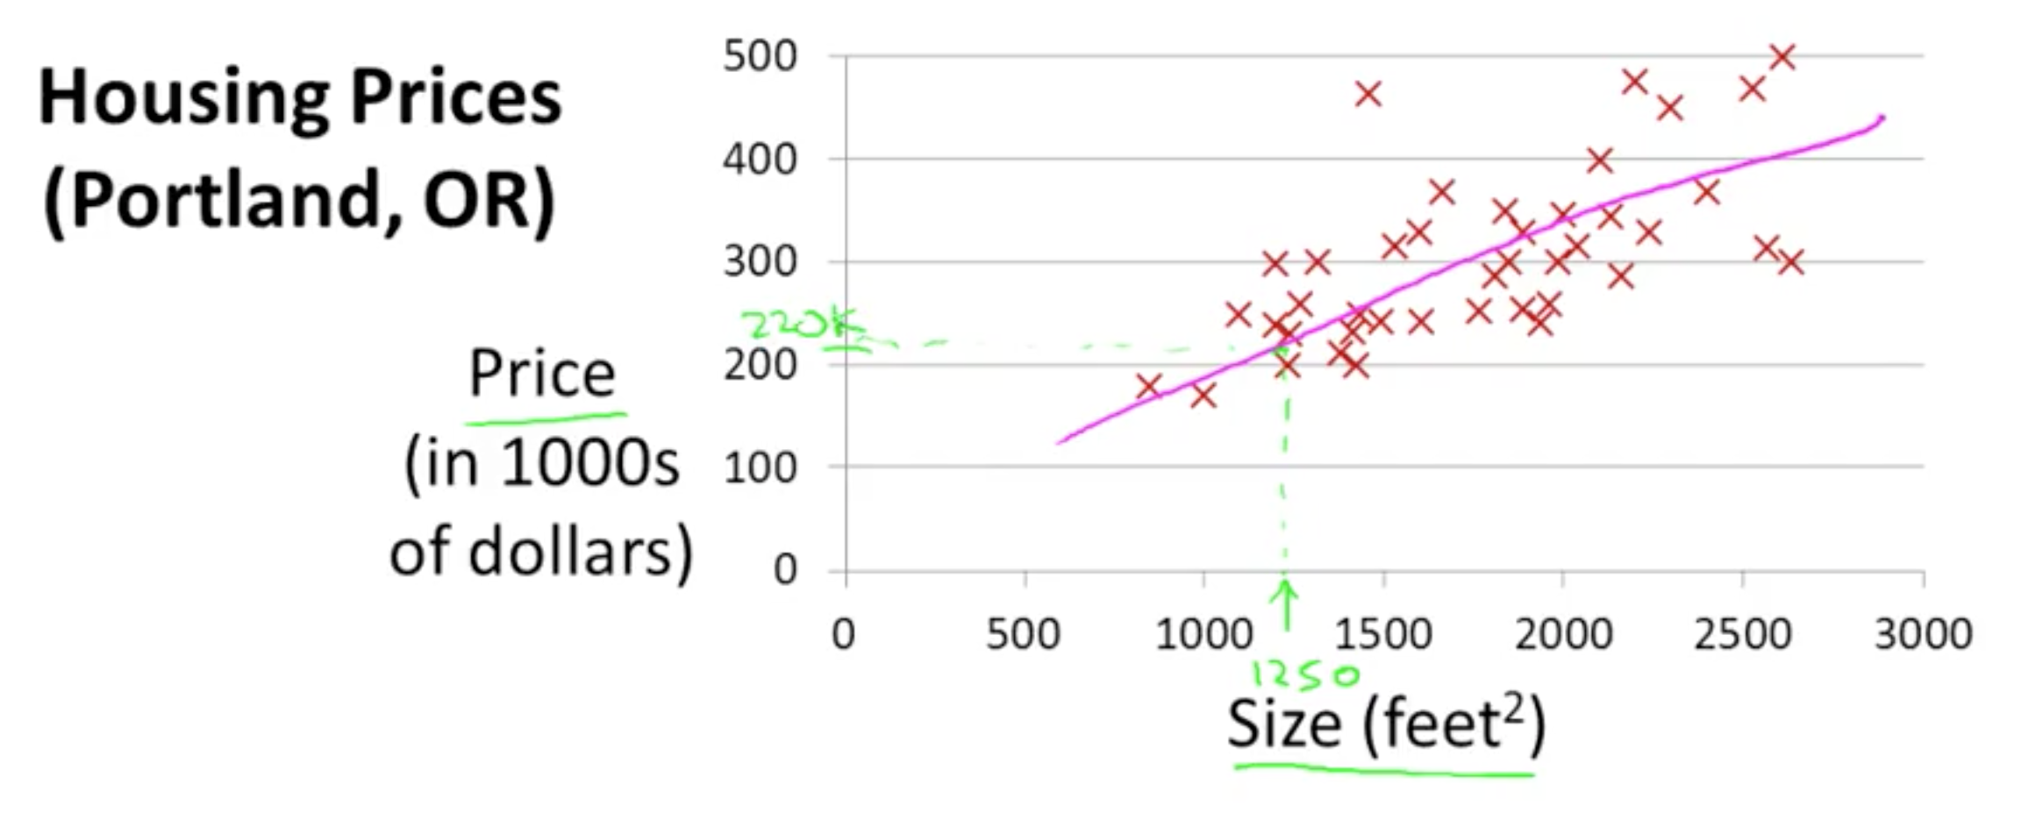
Model representation

Slide 17
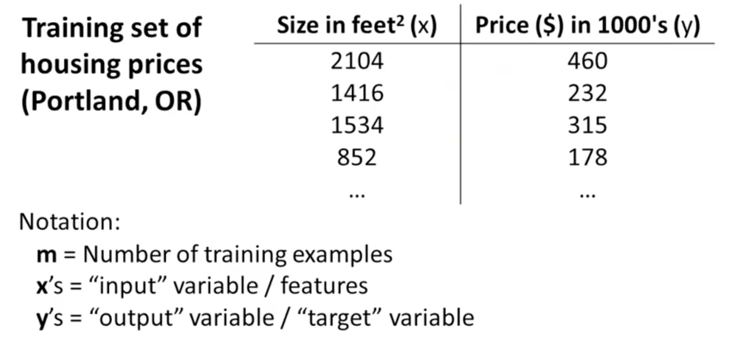
dataset

Slide 18
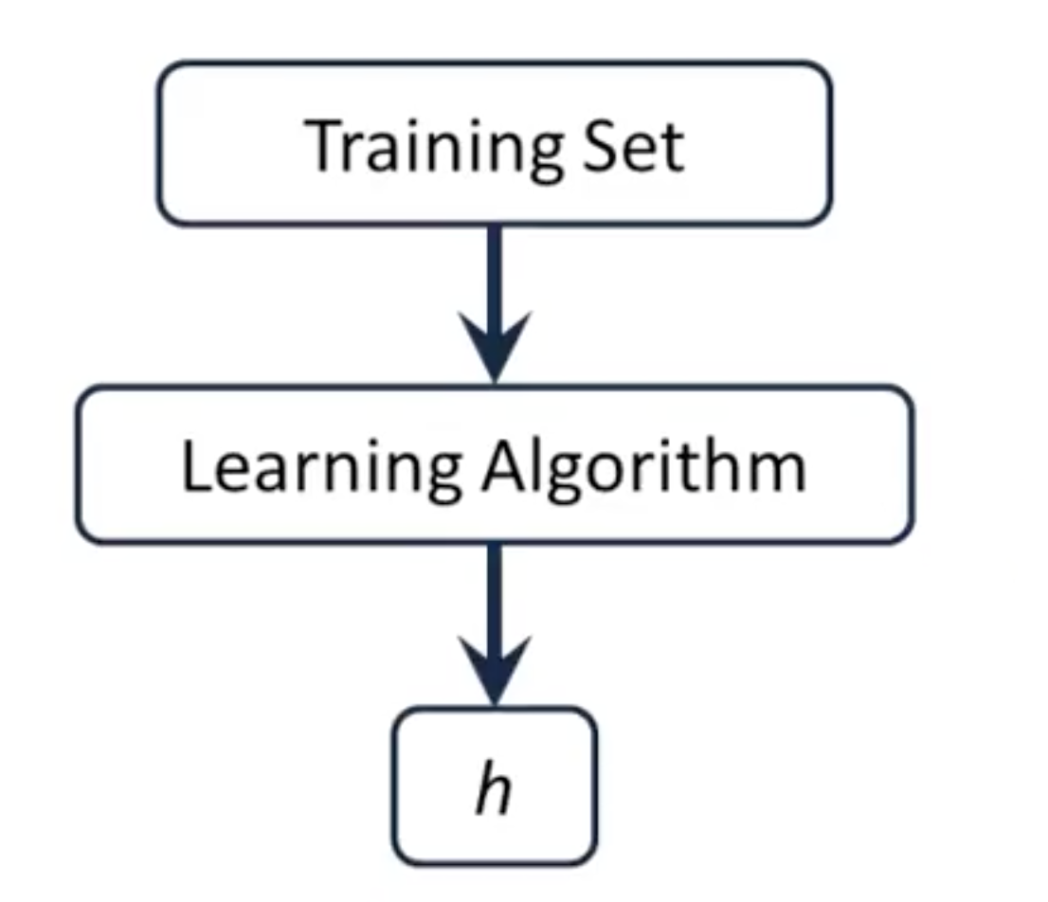
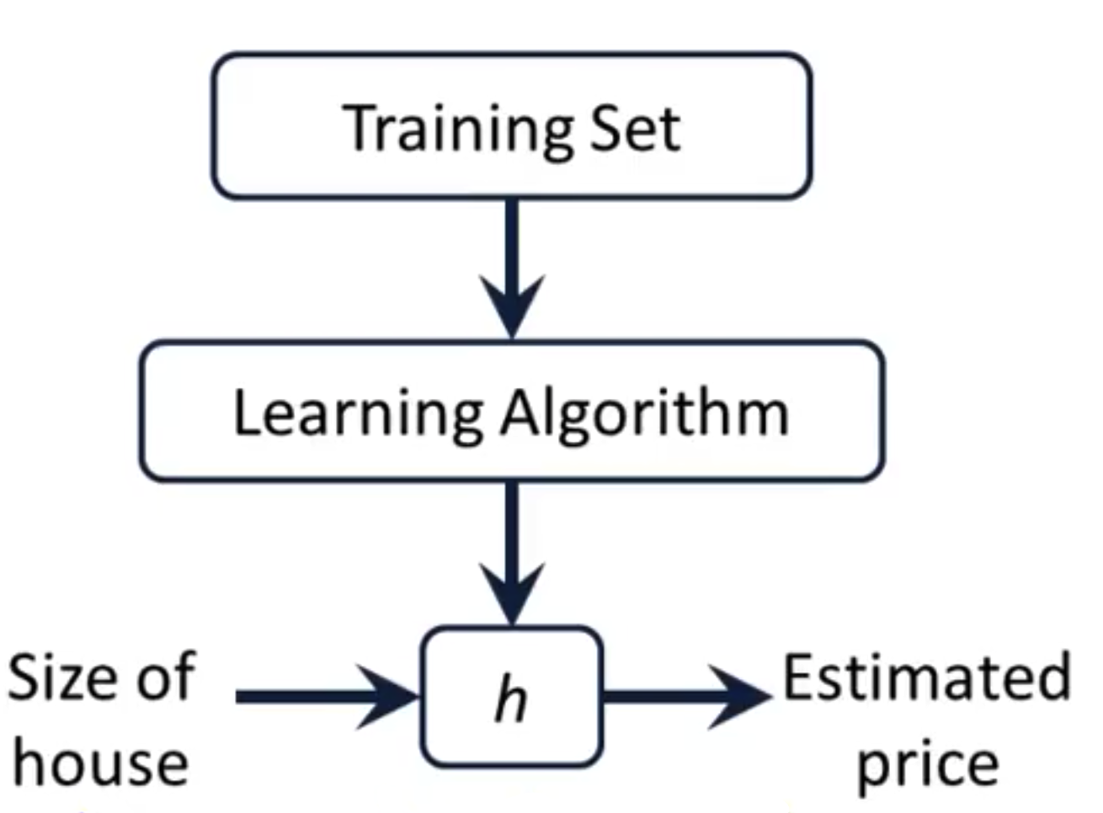
model representation
How do we represent the hypothesis h(x)? h_{Θ}(x) =Θ₀ + Θ₁(x) → Univariate linear regression

Slide 19
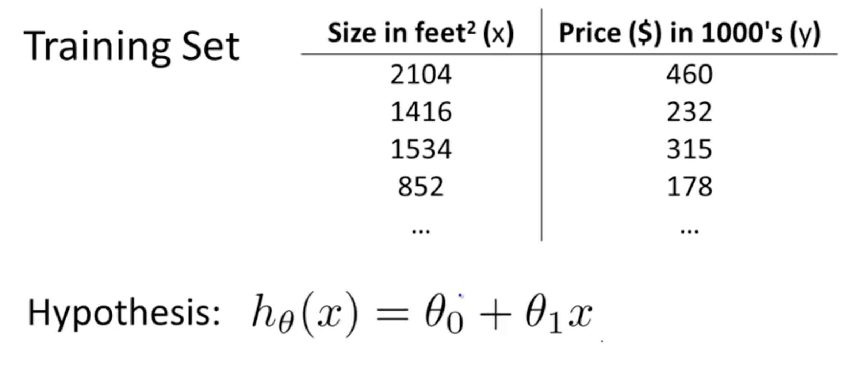
Cost function
How to choose Θ_{i} ?

Slide 20
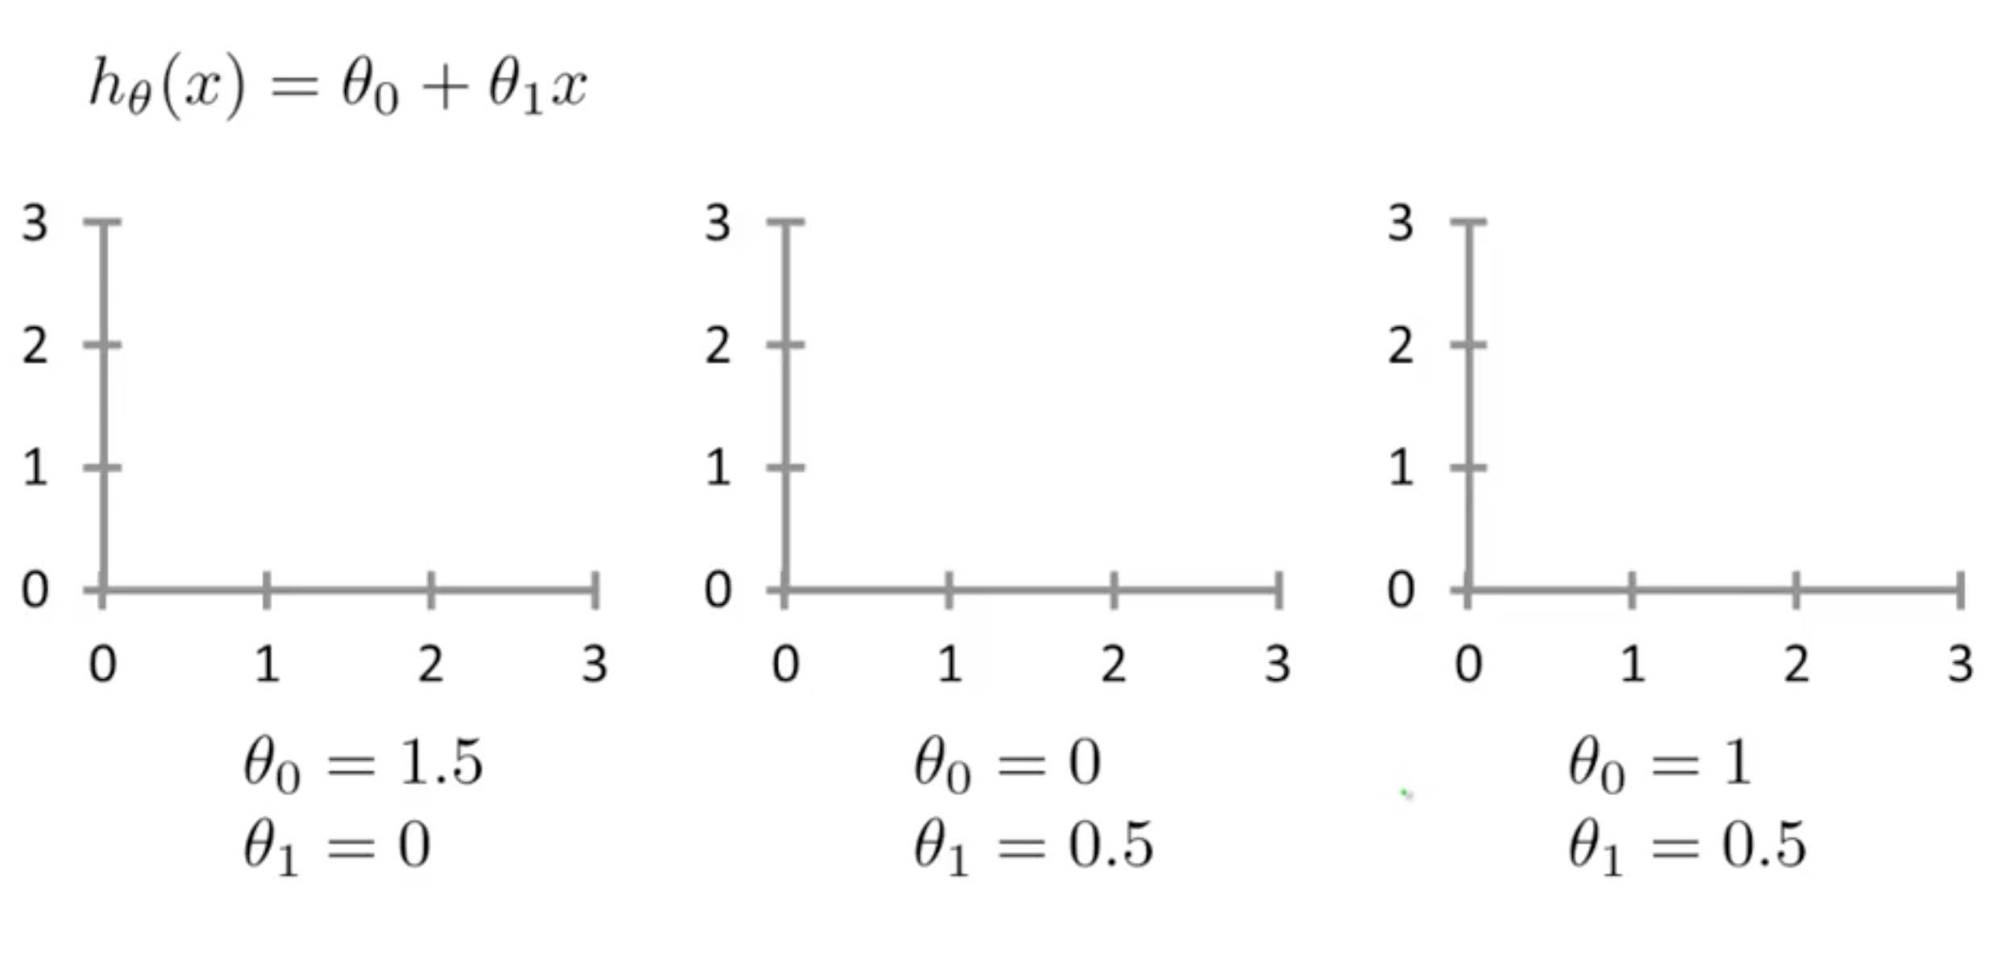
Cost function

Slide 21
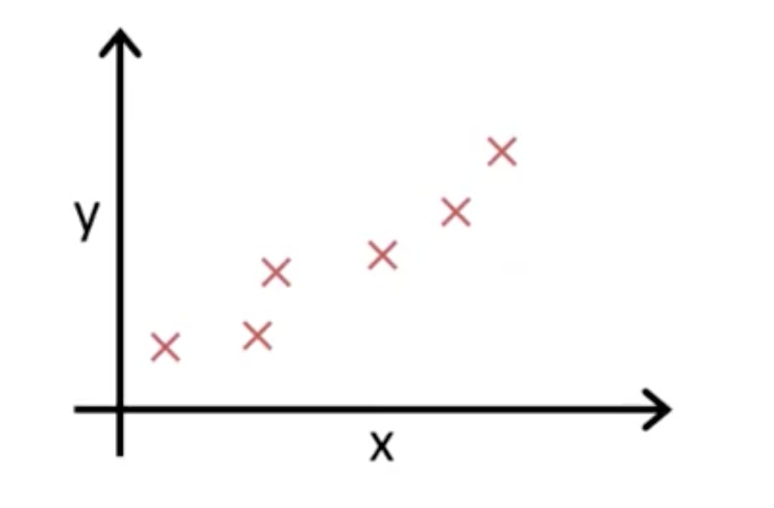
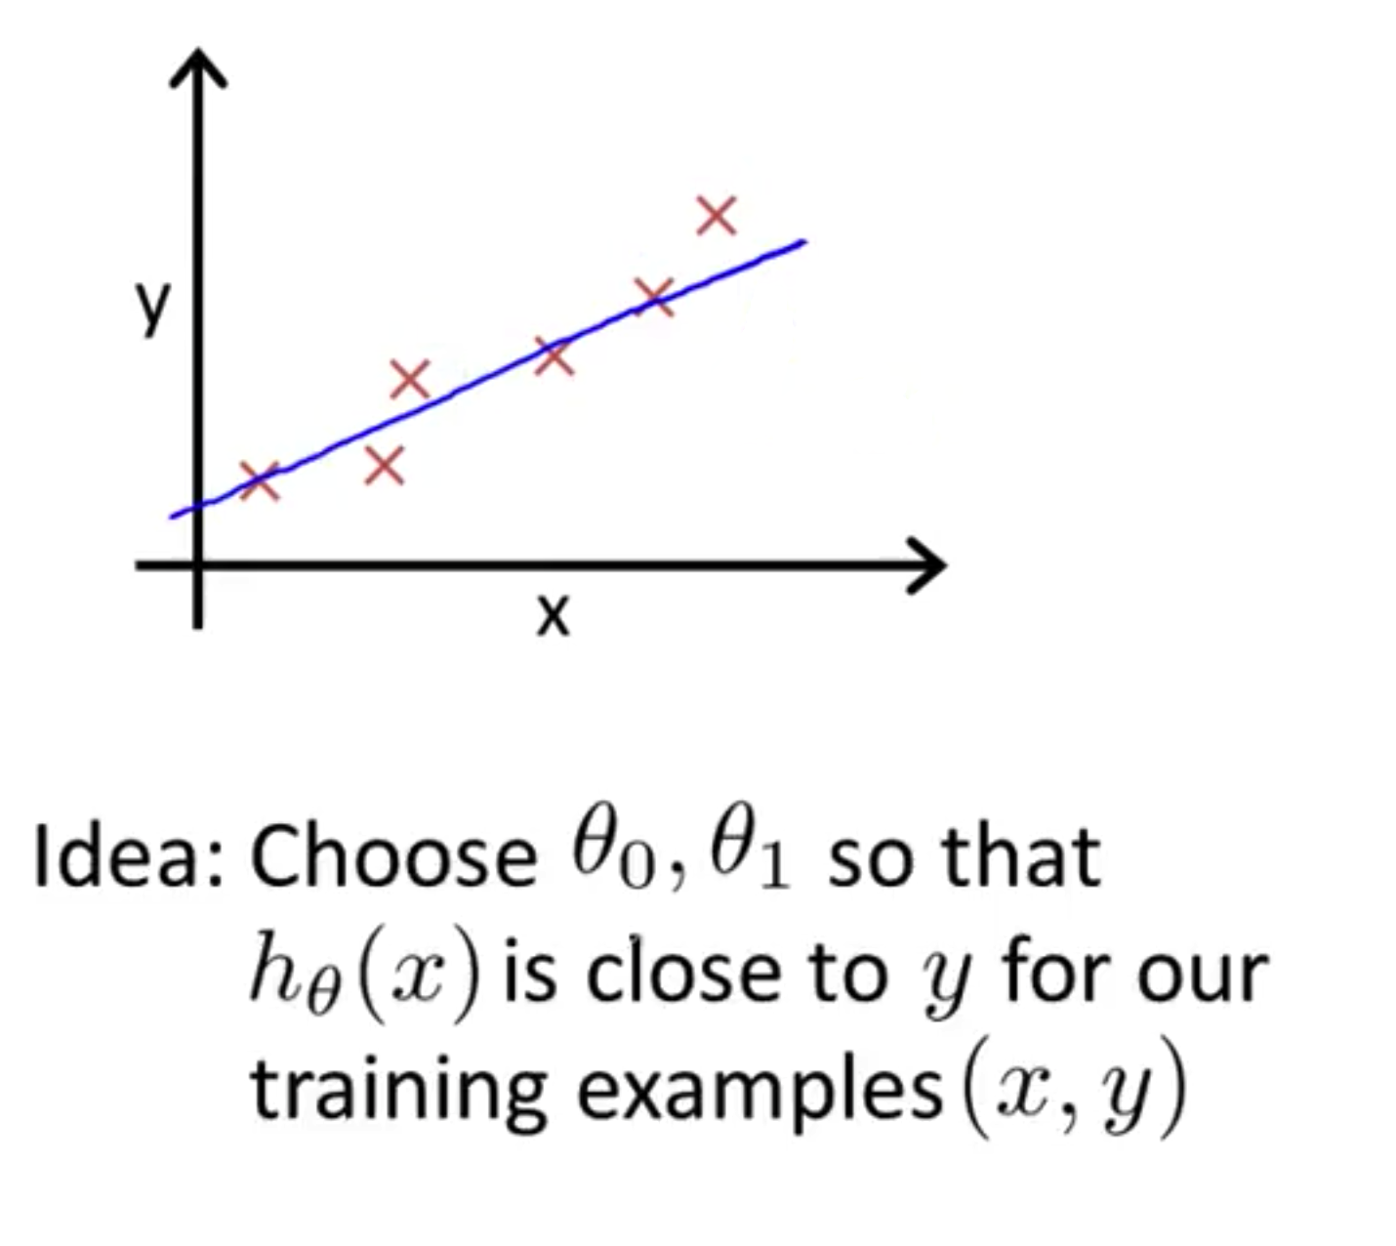
Cost function

Slide 22
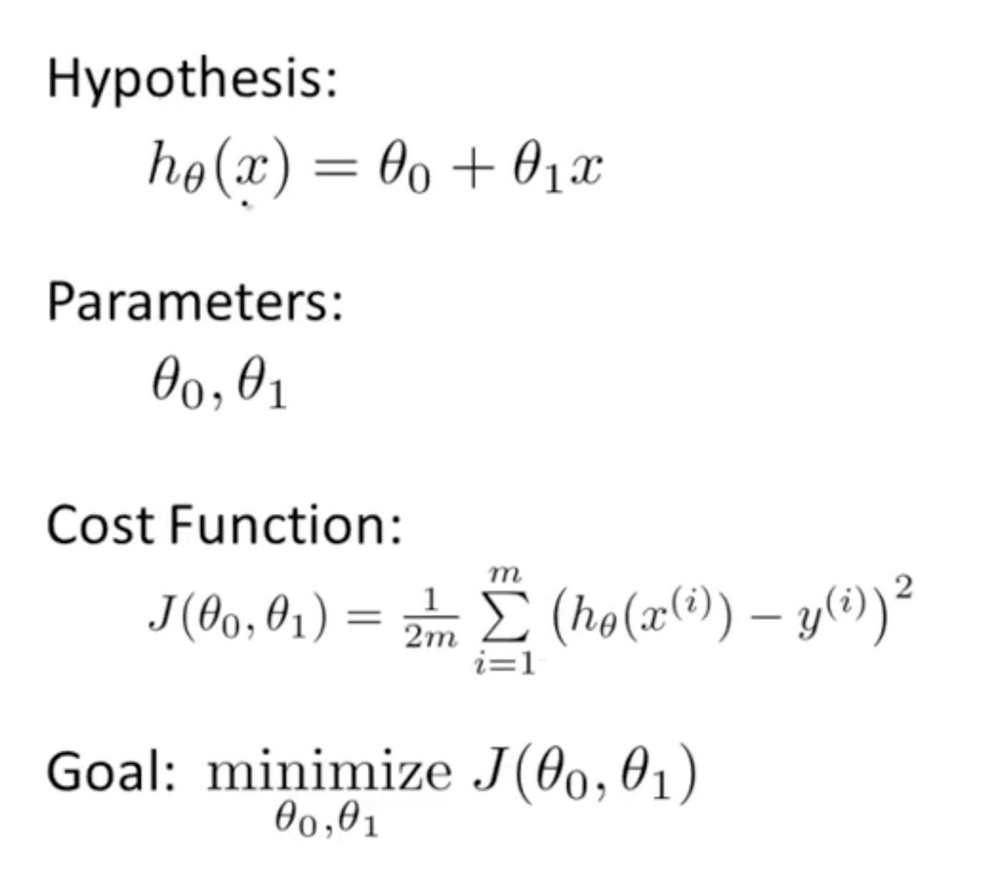
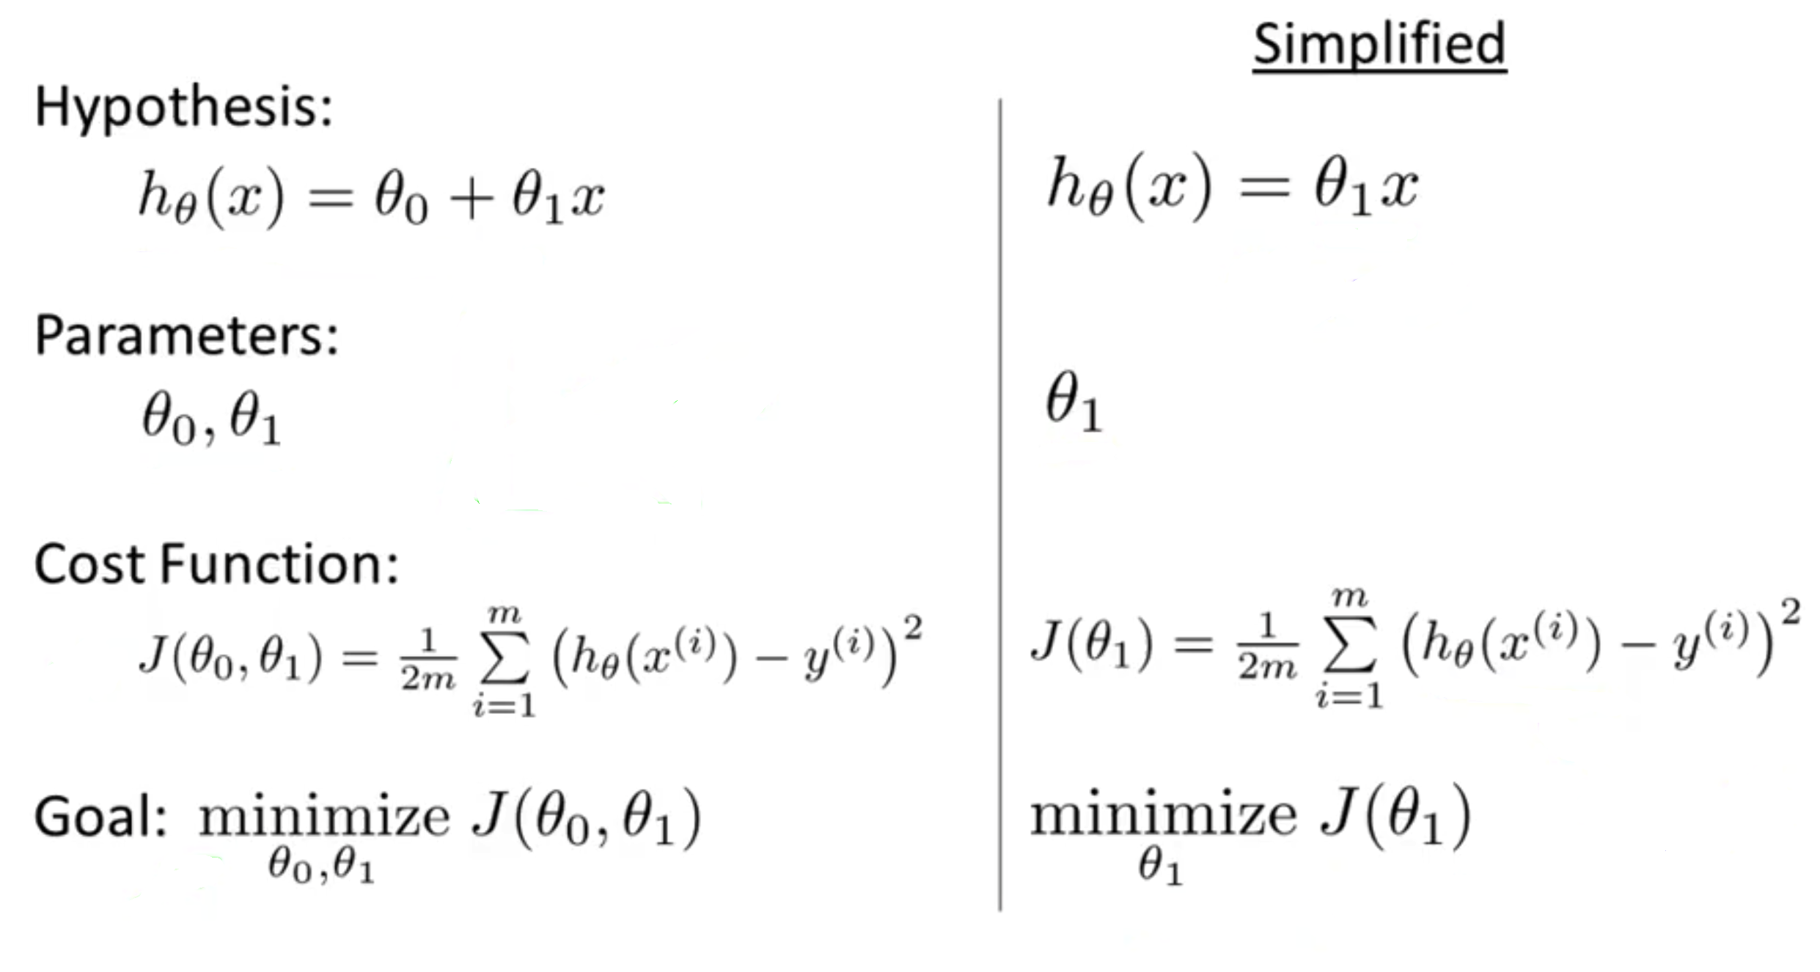
Cost function

Slide 23
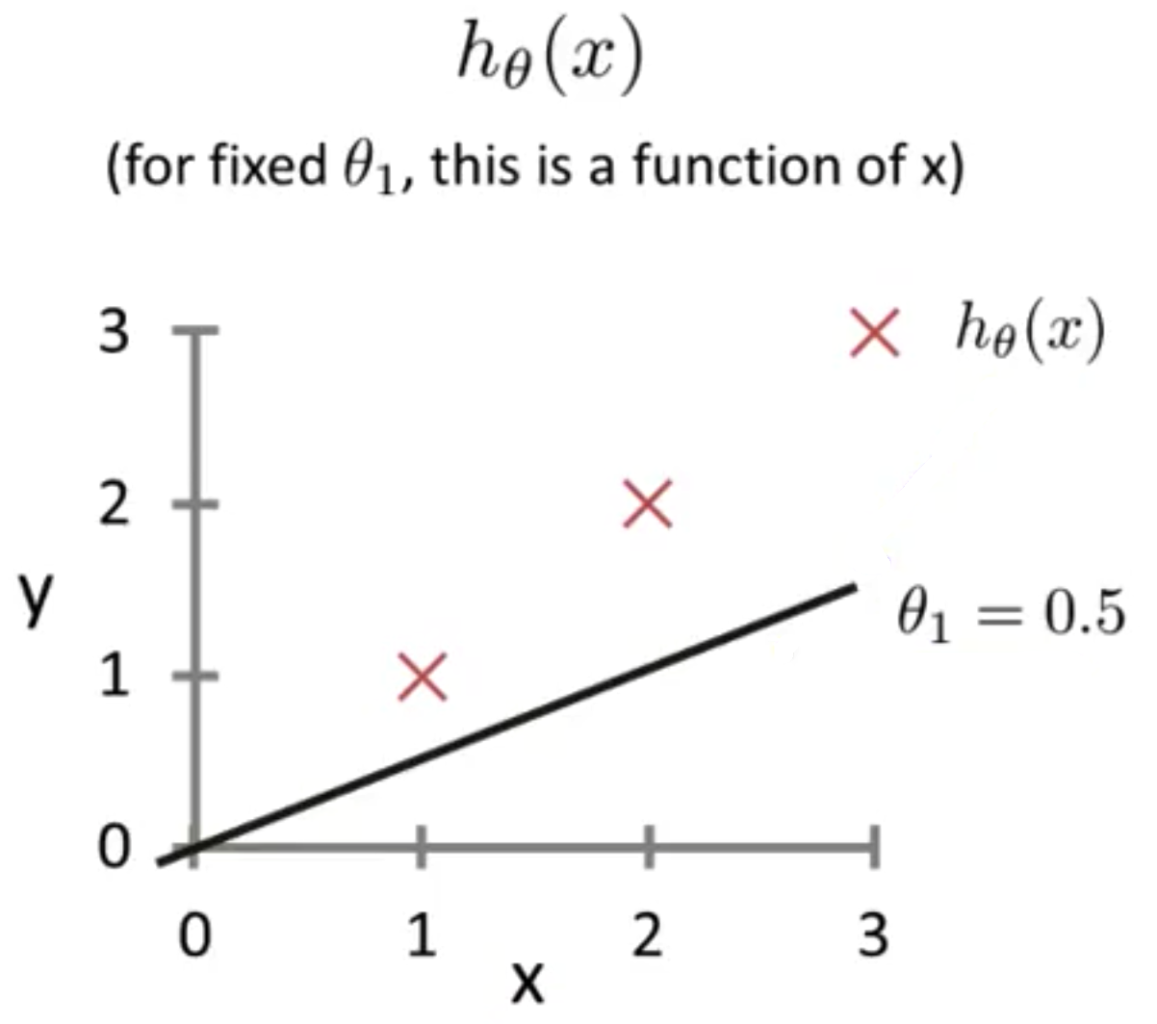
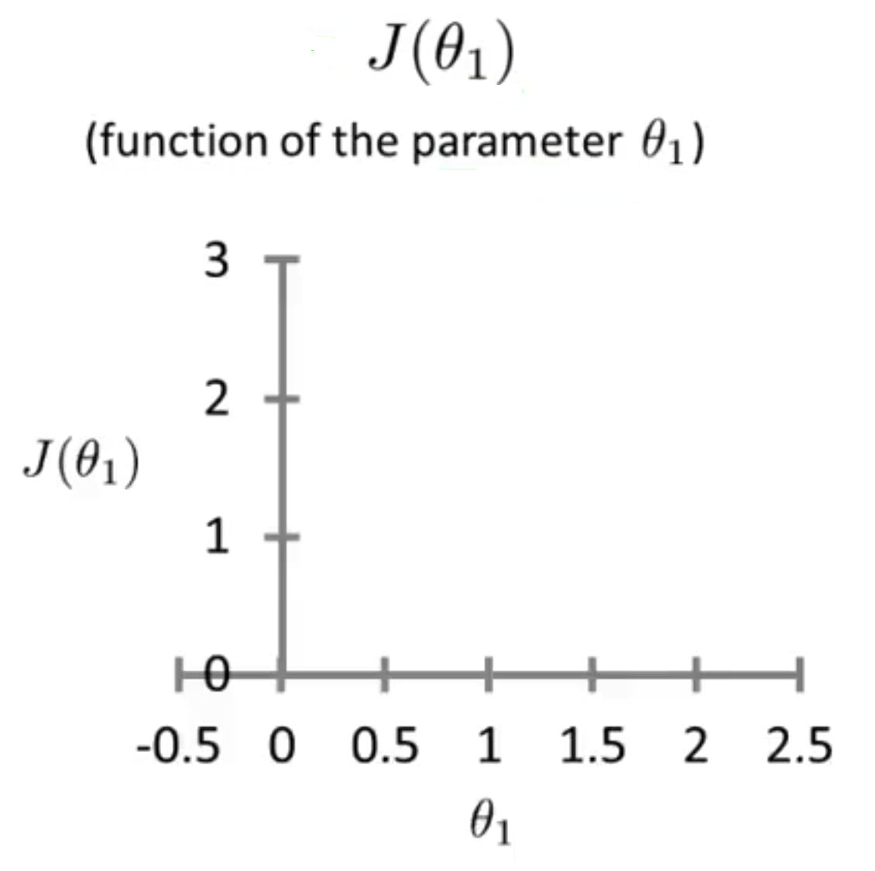
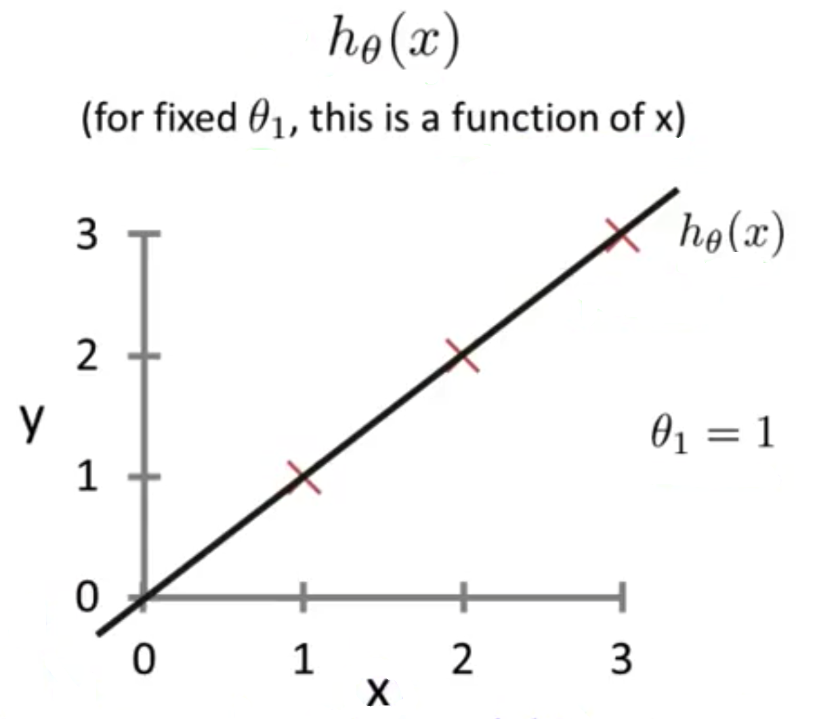
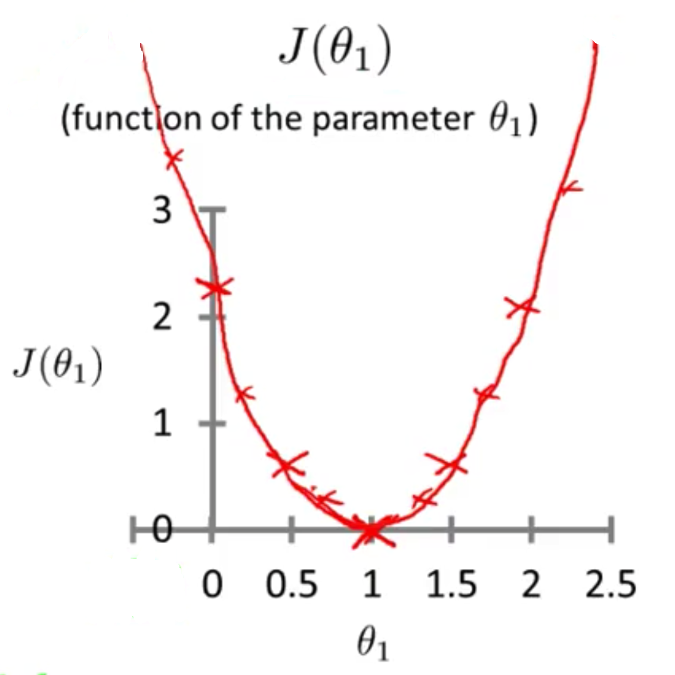
Cost function

Slide 24
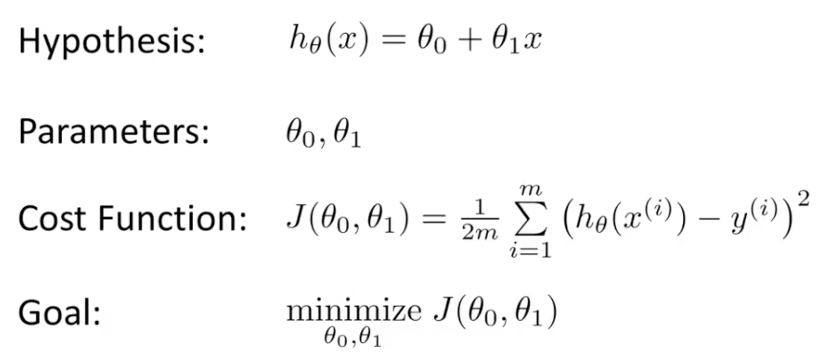
Cost function

Slide 25
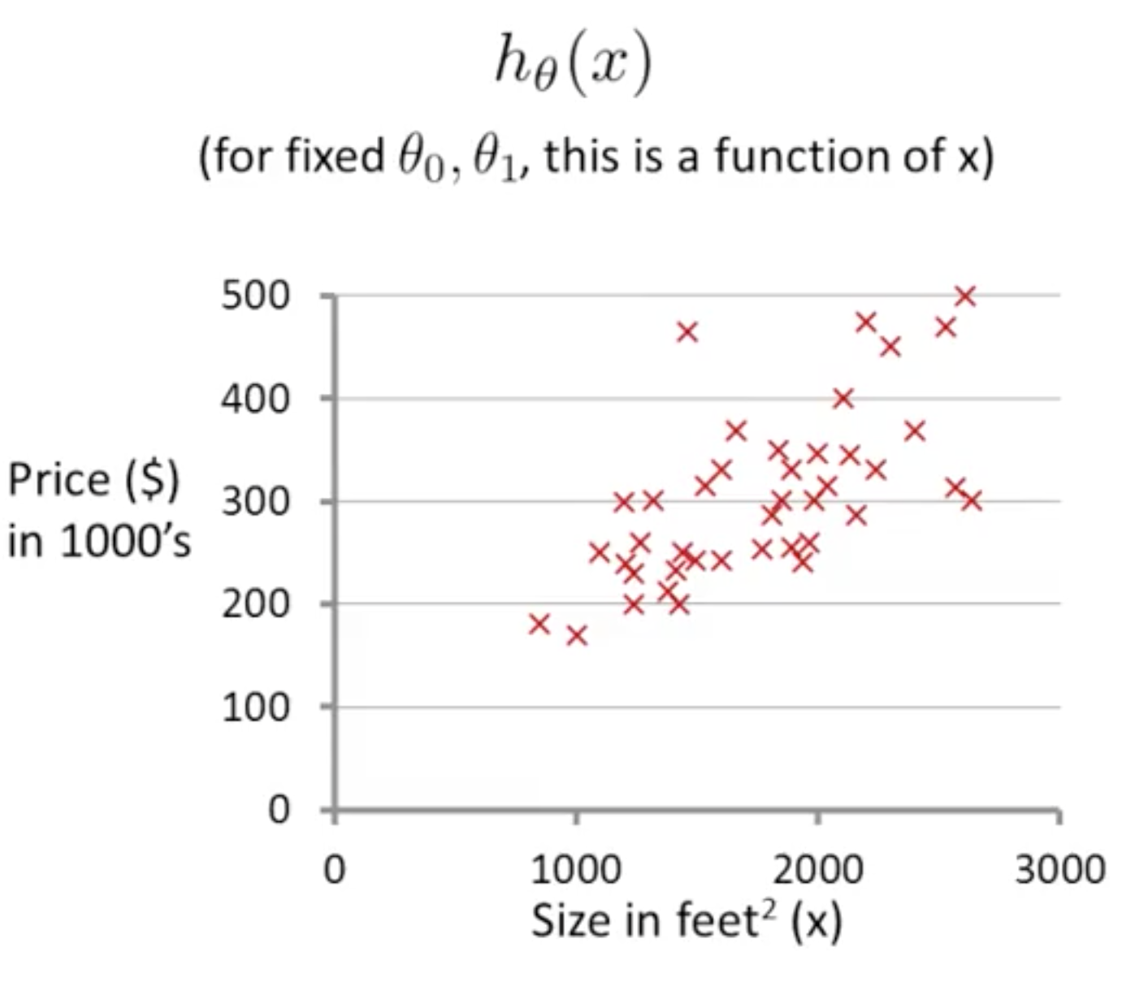
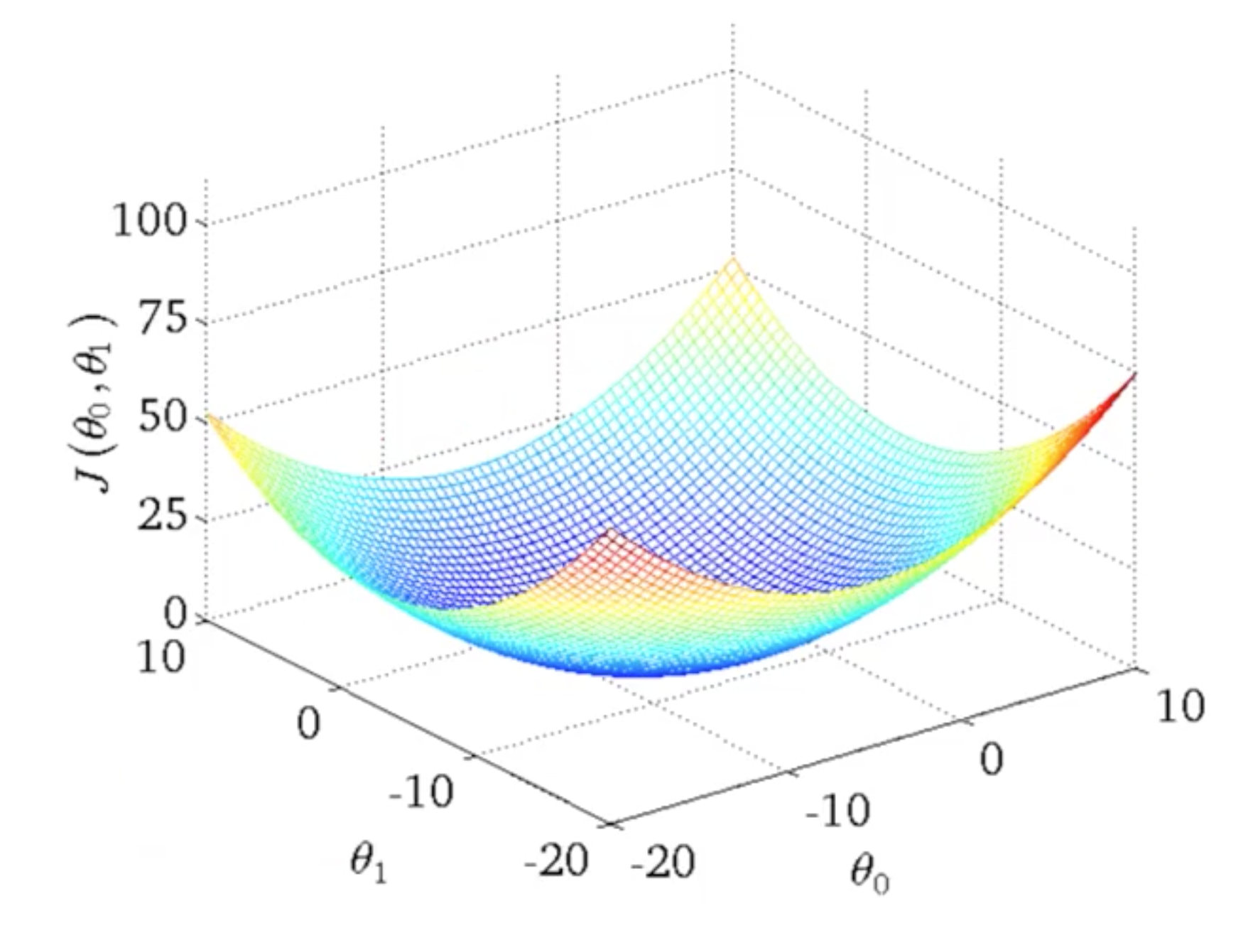
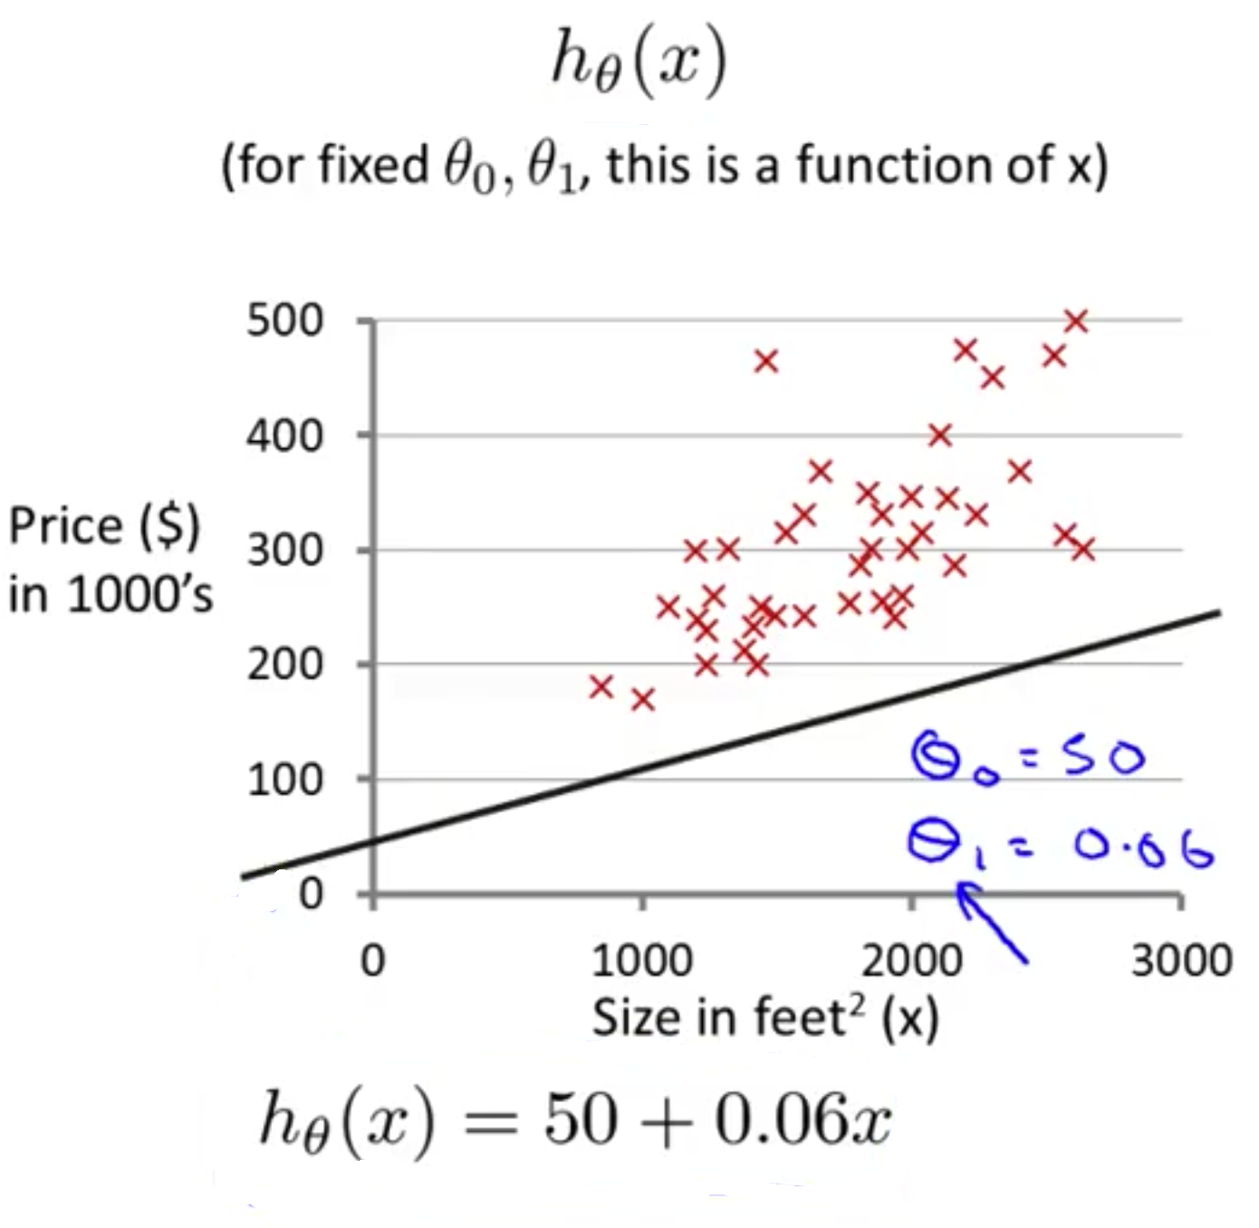
Cost function

Slide 26
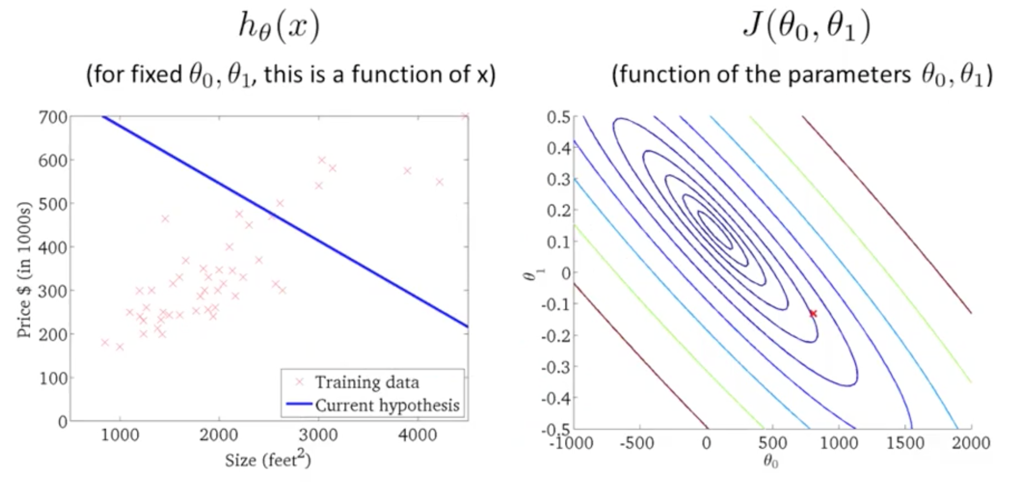
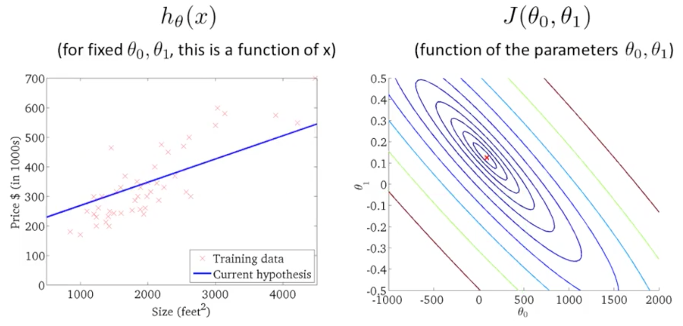
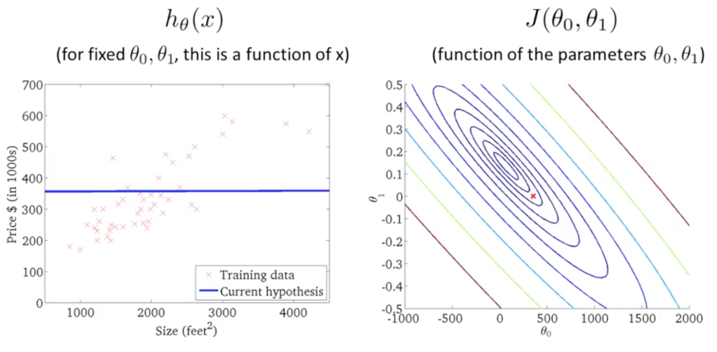
Contour plots - contour figures

Slide 27
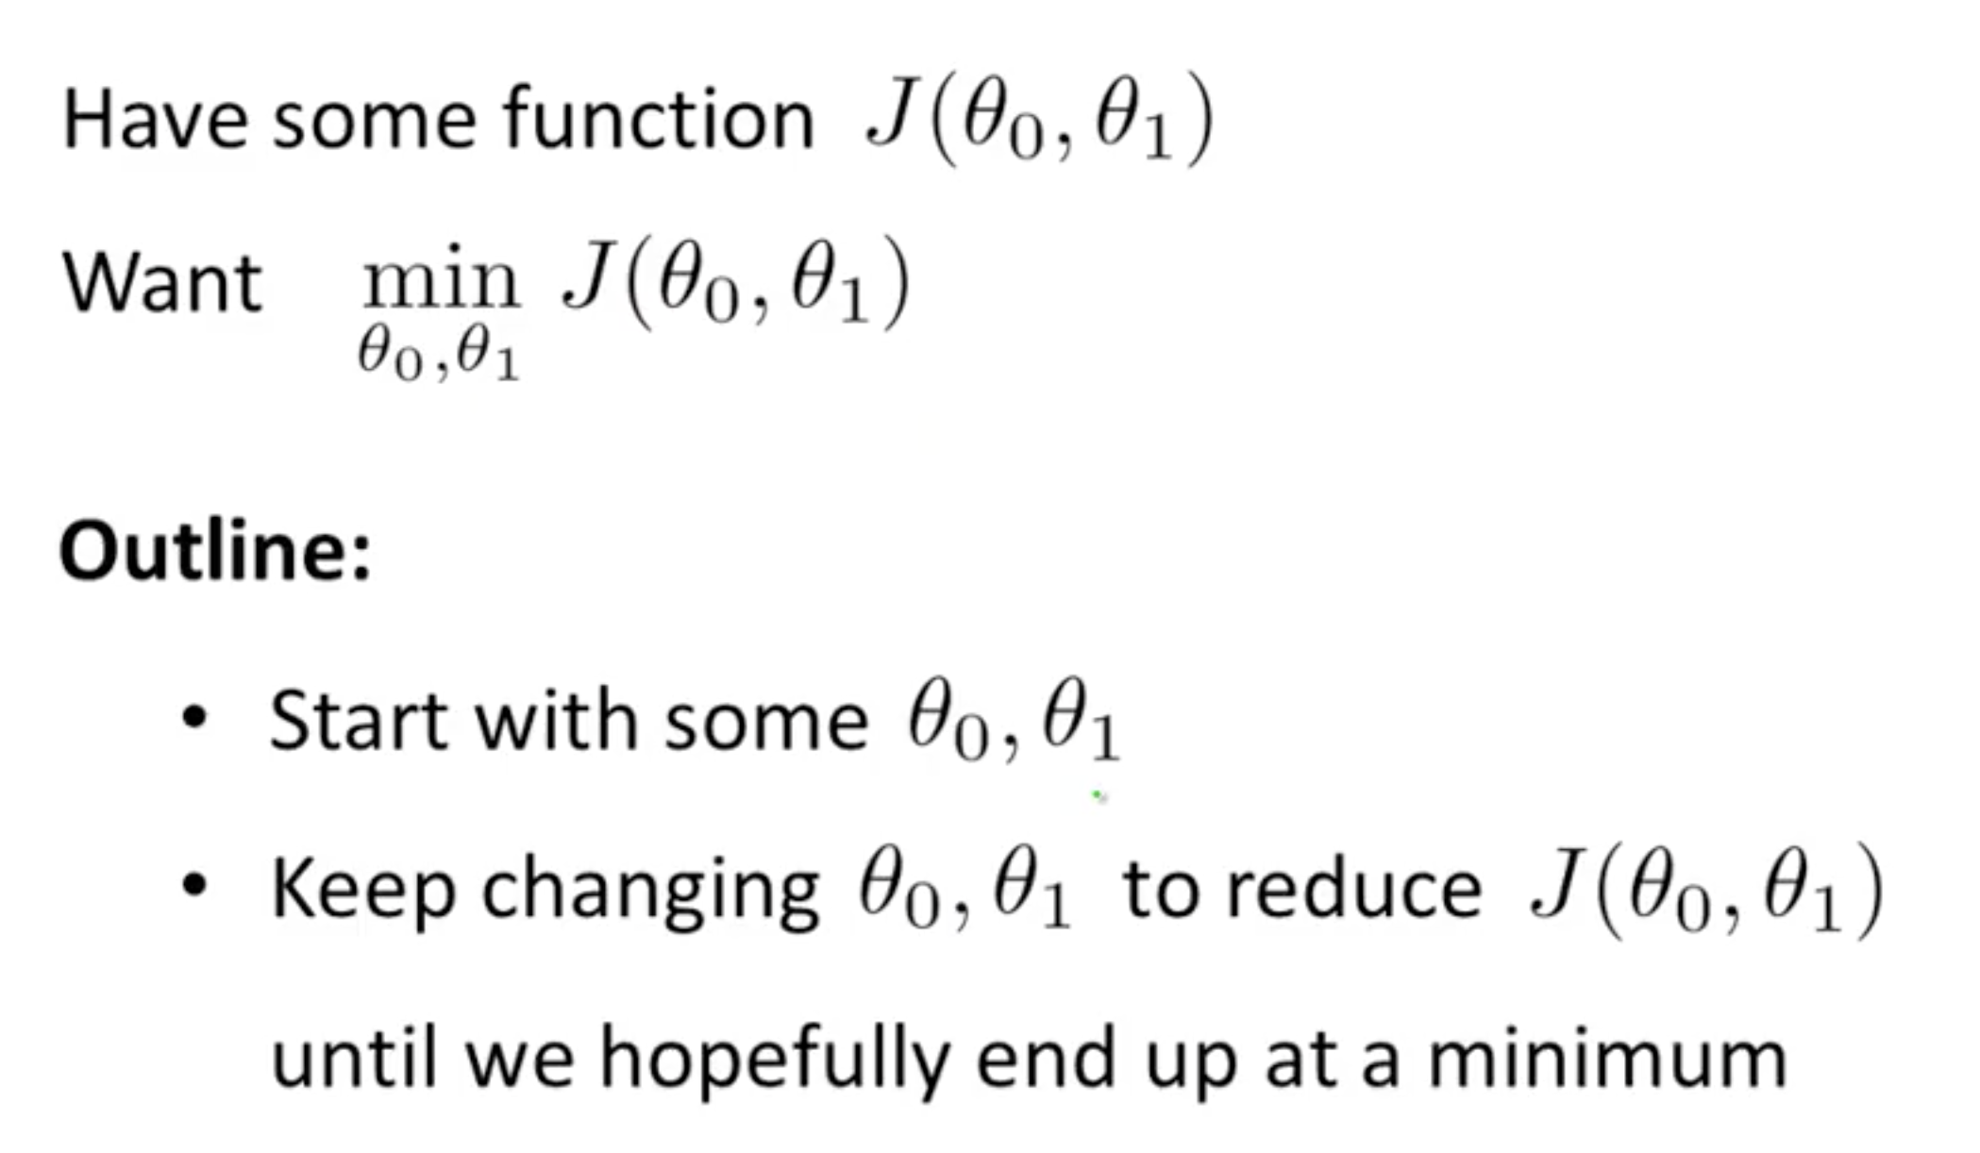
Gradient descent

Slide 28
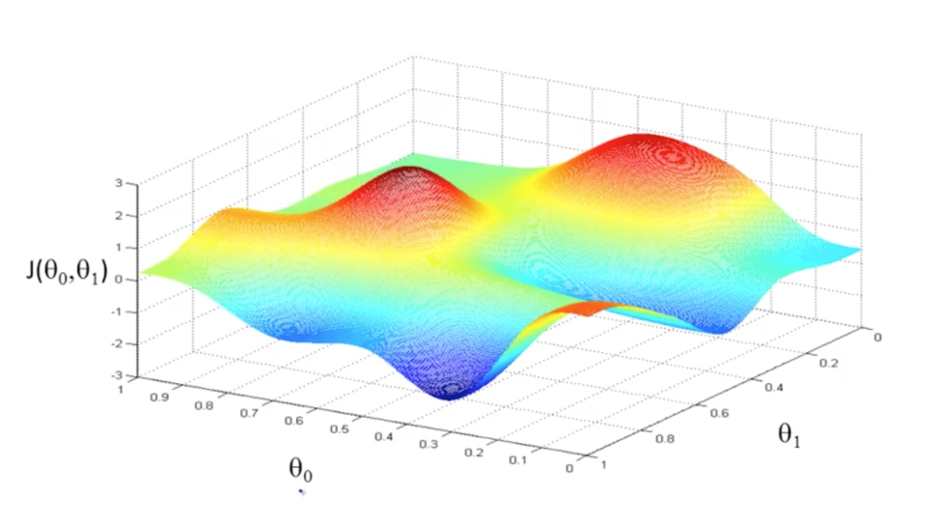
Gradient descent

Slide 29
Gradient descent

Slide 30
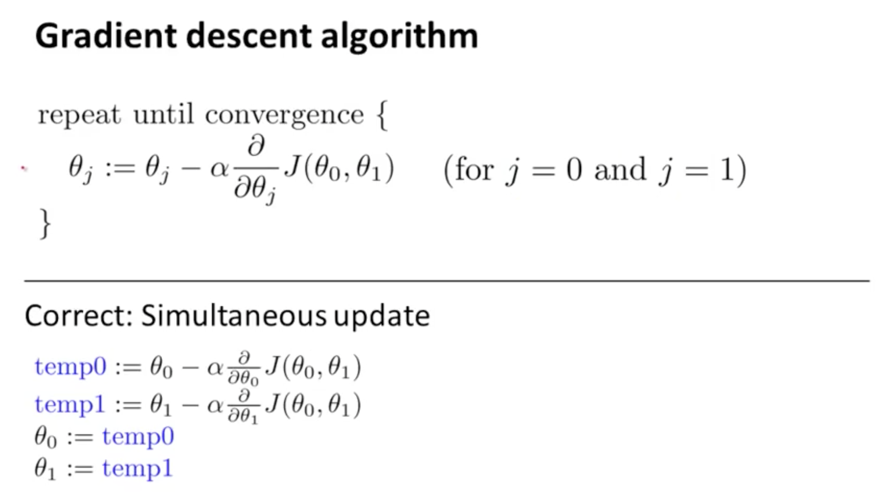
Gradient descent

Slide 31
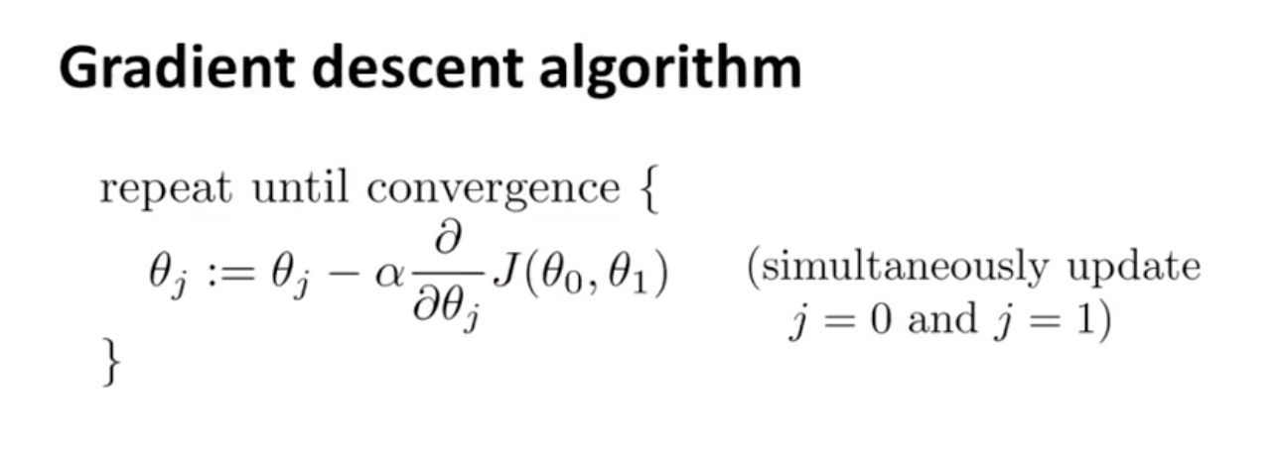
Gradient descent
Simplified: Minimum J(Θ₁) with one variable Θ₁

Slide 32
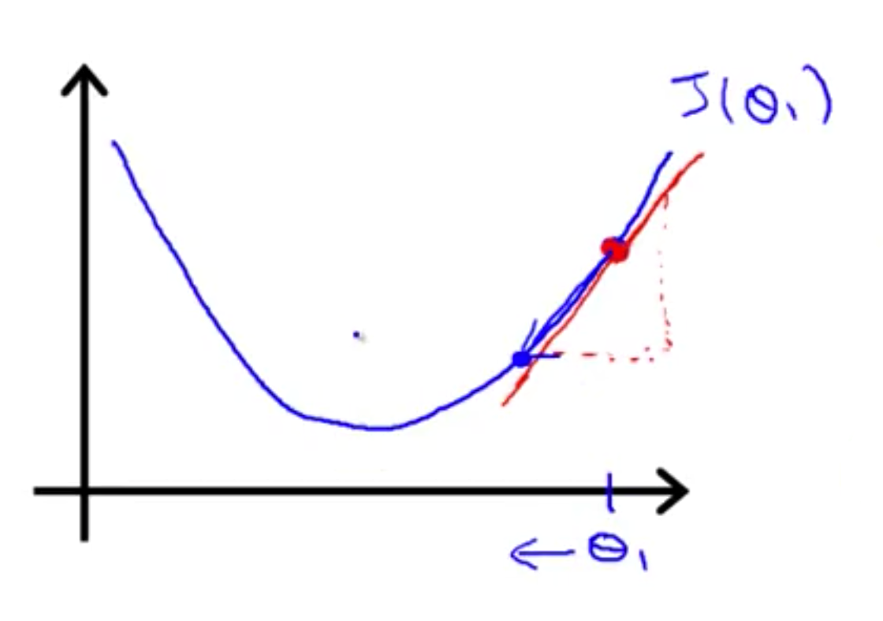
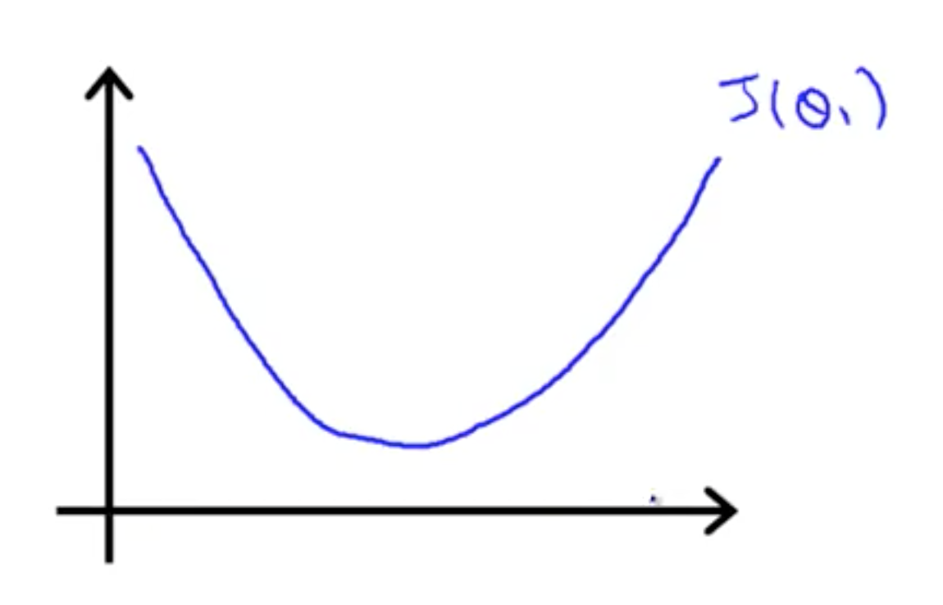
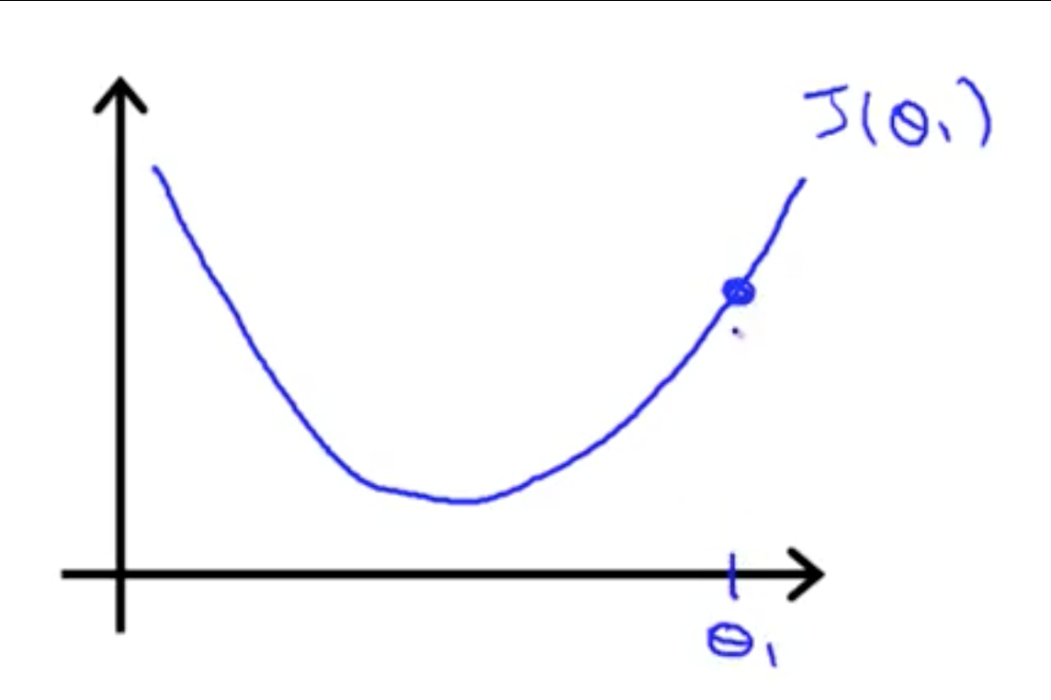
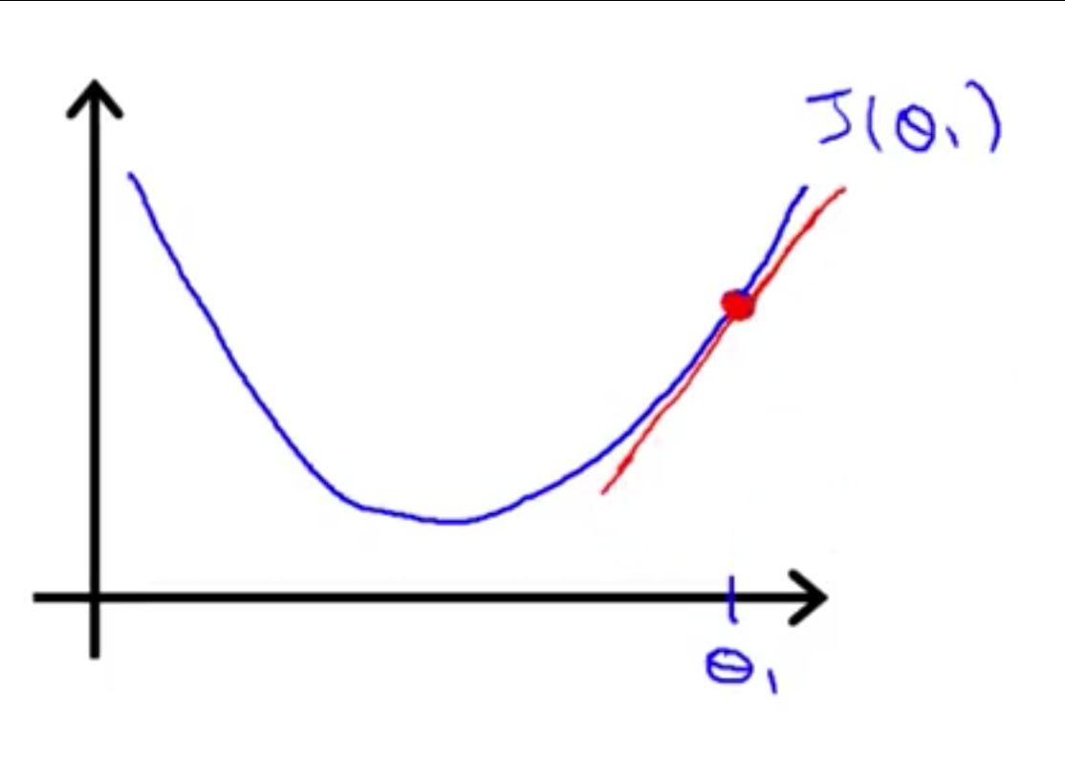
Gradient descent

Slide 33
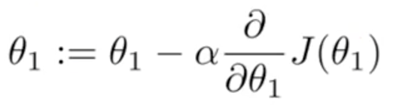
Gradient descent
If α is too small, gradient descent can be slow
If α is too large, gradient descent can overshoot the minimum. It may fail to converge, or even diverge

Slide 34
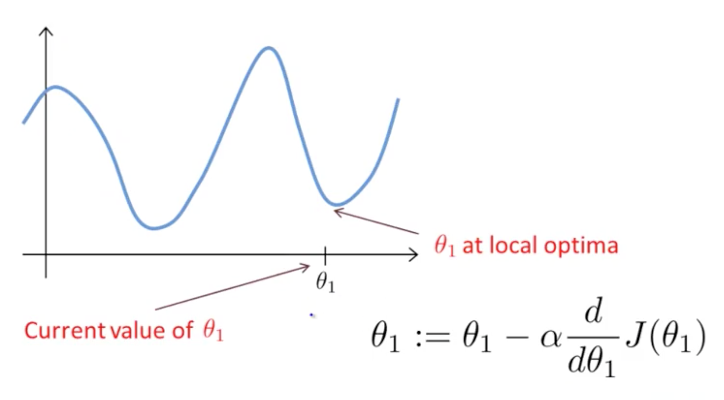
Gradient descent

Slide 35
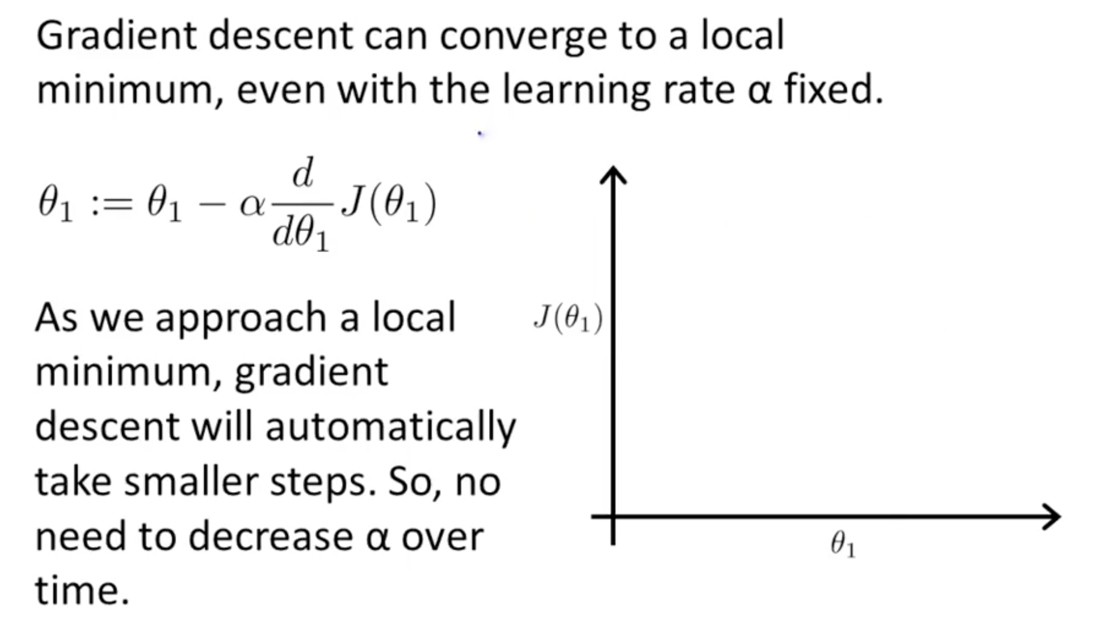
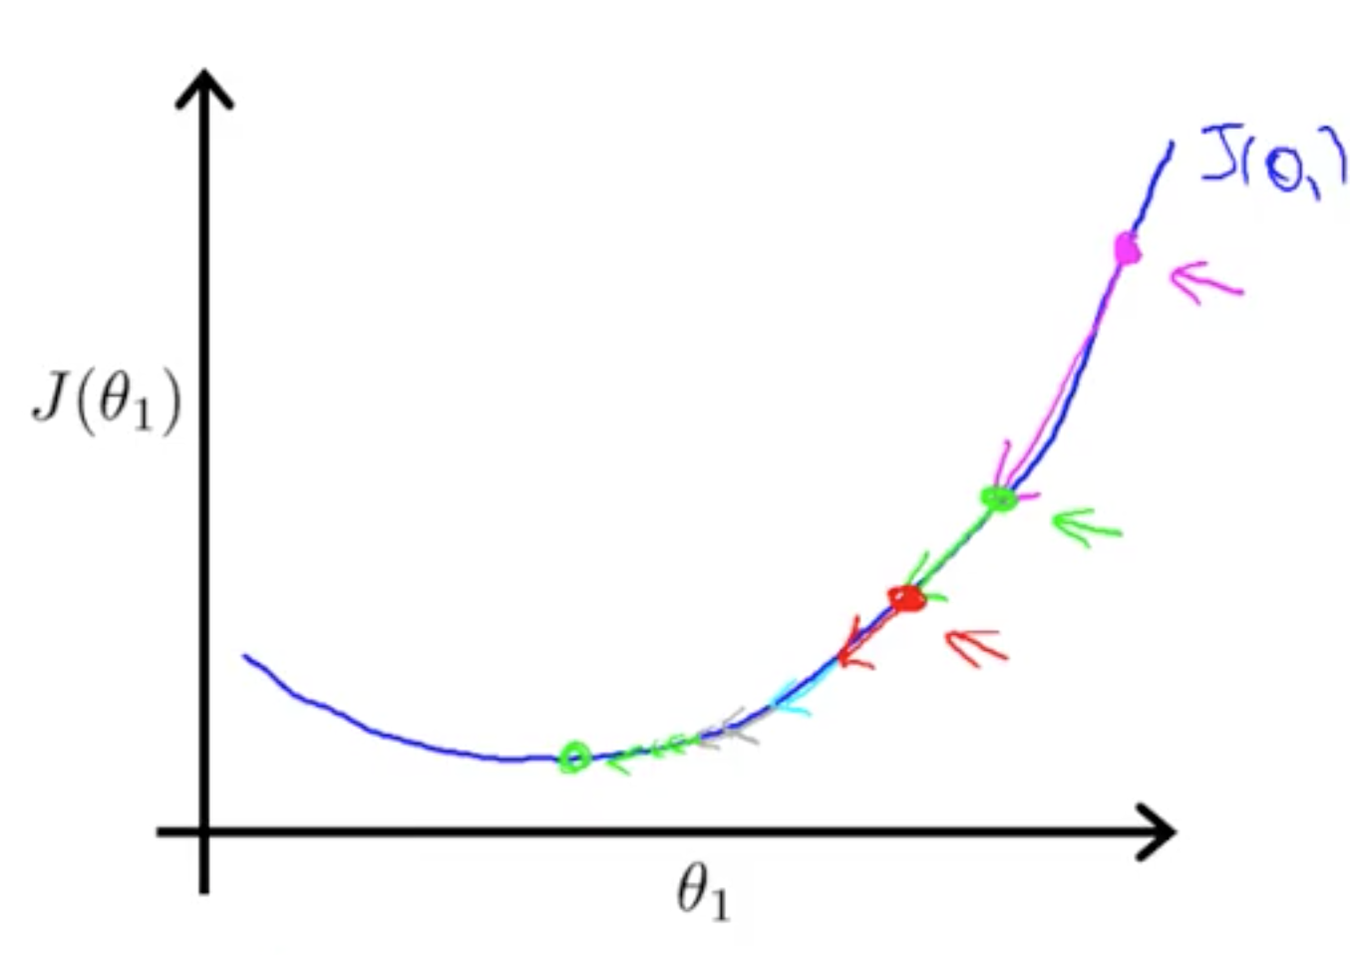
Gradient descent

Slide 36
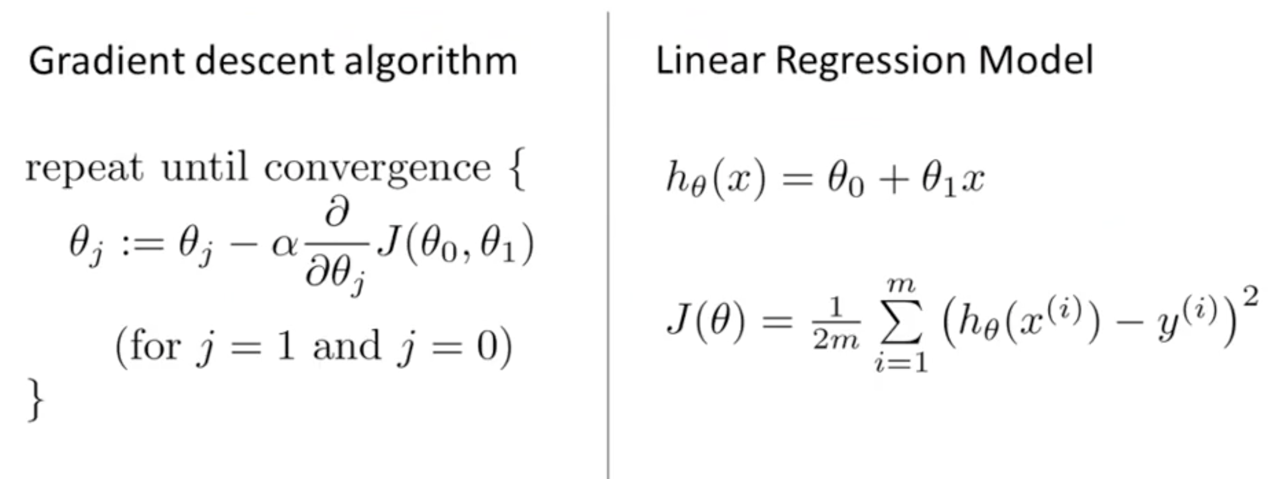
Gradient descent for linear regression

Slide 37
Gradient descent for linear regression

Slide 38
Gradient descent for linear regression

Slide 39
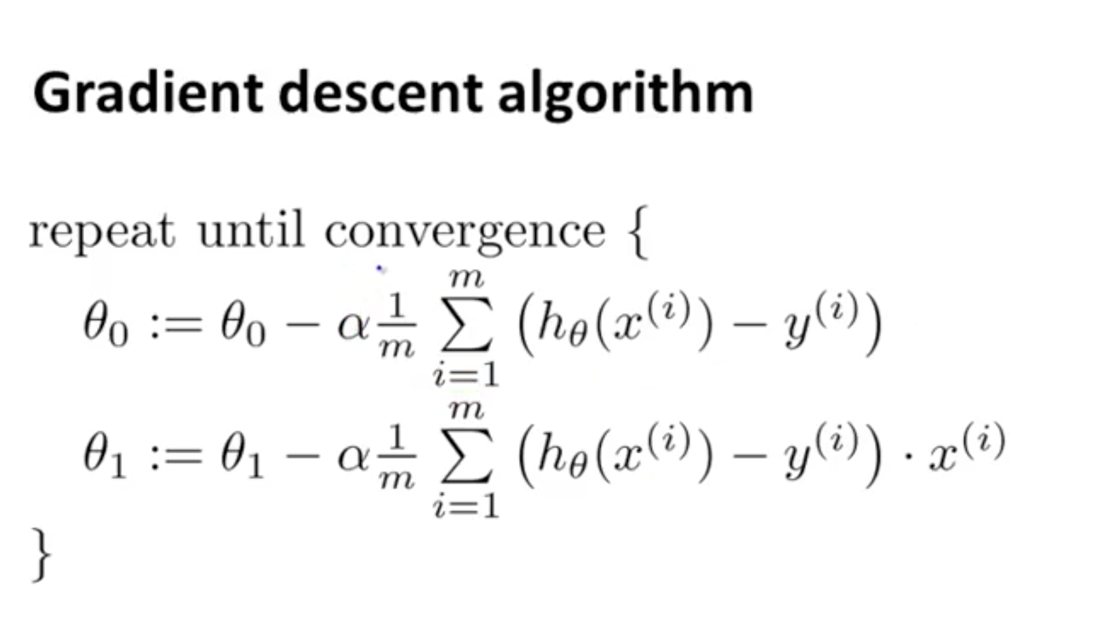
Gradient descent for linear regression

Slide 40
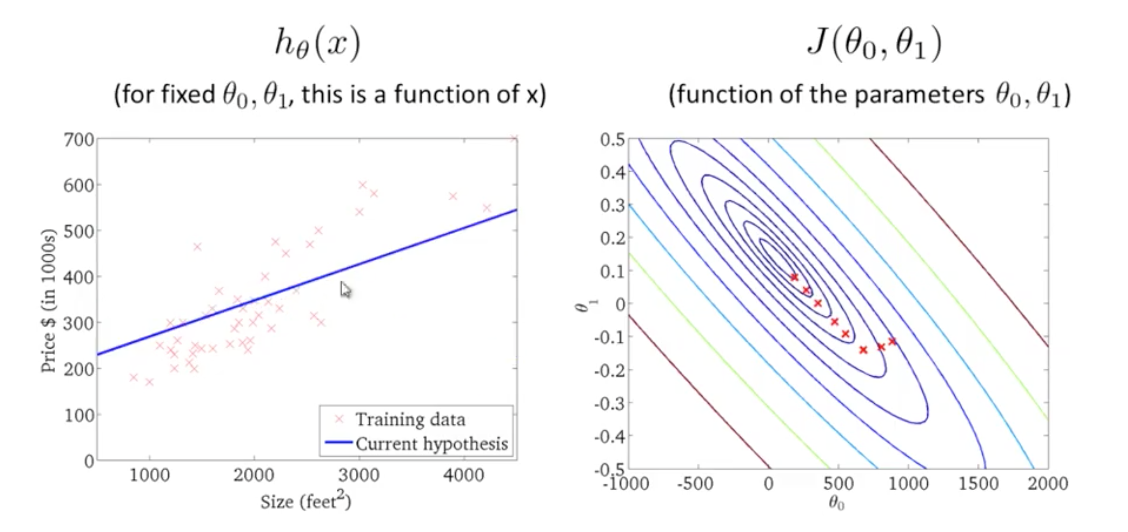







Gradient descent for linear regression

